Slide 1
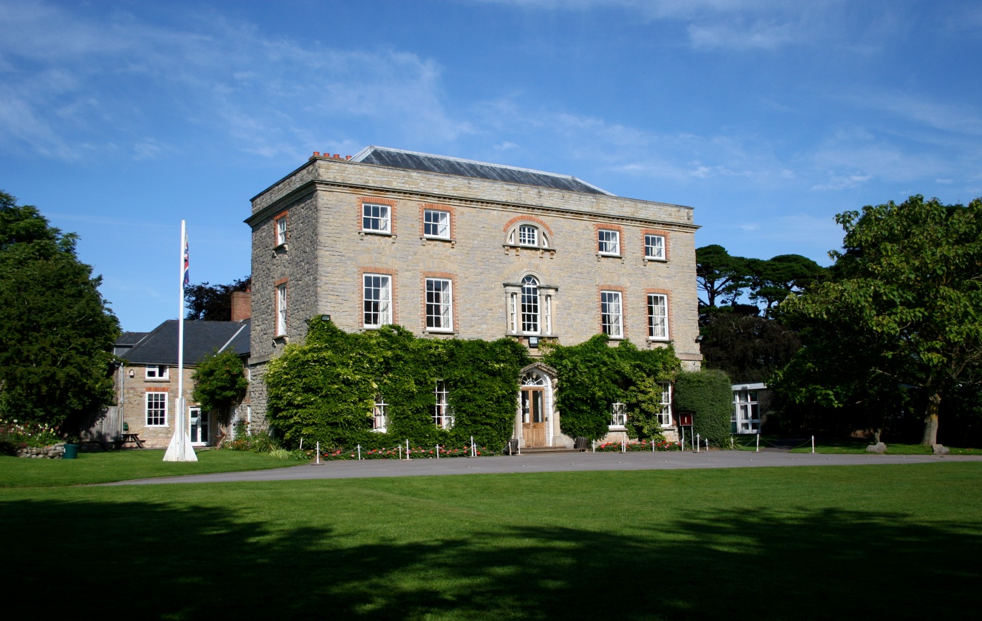
Year 4 Kilve Court
2024
Wednesday 18th-20th September
2024

Slide 2
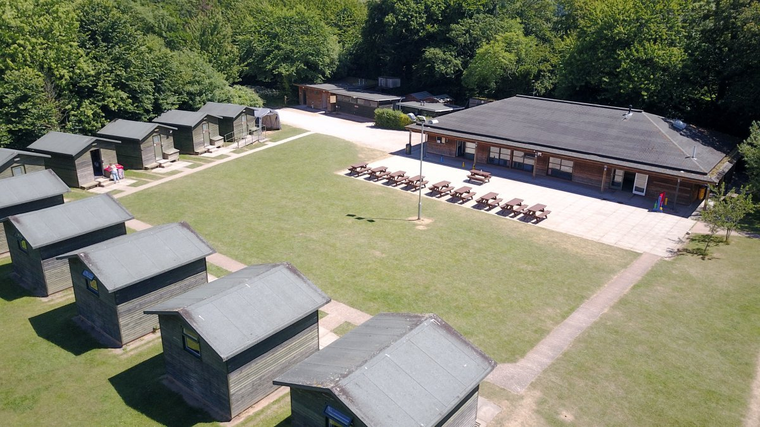
Outdoor Centre

Slide 3
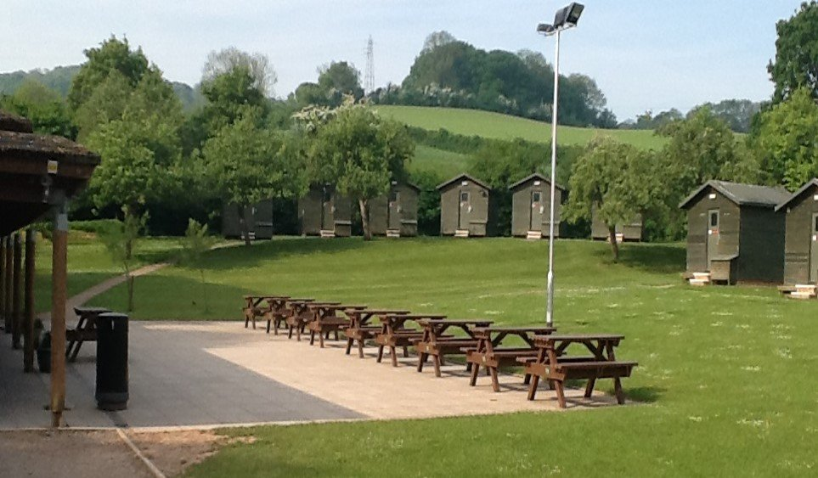
Cabins and Picnic Area

Slide 4
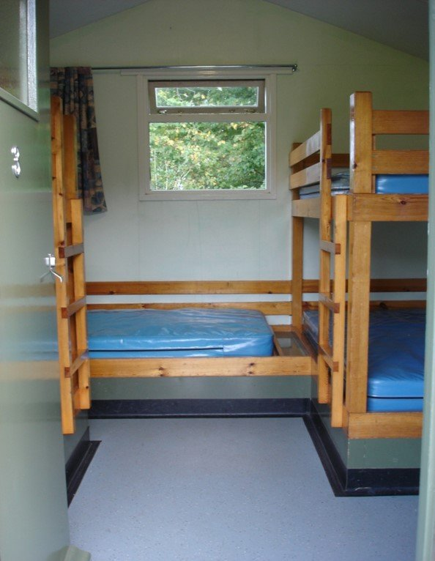
Bedrooms

Slide 5
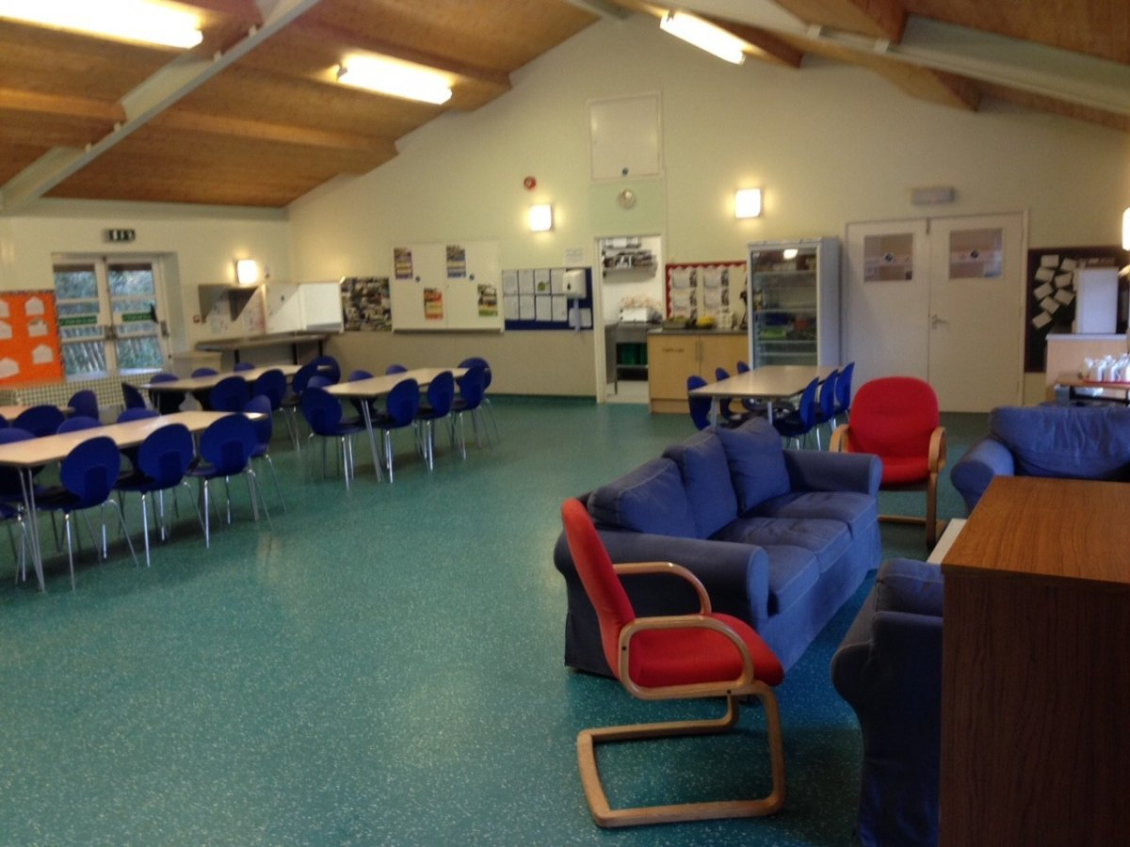
Dining Area

Slide 6
Staff
Mr Lake
Mrs Higgins
Mrs Baird
Miss Fortune
Mrs Cozens

Slide 7
Activities
Team Building Grass Sledging
Abseil Tower Low Ropes Course
Rifle Shooting
Mountain Biking
Fantasy Trail
Beach Walk/Fossil Hunting
Camp Fire, marshmallows, hot chocolate
Disco

Slide 8
Facilities
Outdoor Centre – Kilve Court
Rooms for between 4 to 5 children – the children will be with at least one person they have already named. They will be told their rooms when we arrive at Kilve.
Staff rooms nearby
Private showers and toilets
Common room
Drying room
Dining room
Gift Shop - £5max.

Slide 9
A typical day
8:30am Breakfast bell rings
9:30am Activities
10:45am Morning Break
11:15am Activities
1:00pm Lunch
1:45pm Activities
4.30pm Afternoon Break
5.00pm Diaries/relax
6:30pm Dinner
7:30pm Evening activities
Bed time 9.00/10.00

Slide 10
Catering
3 meals a day – so no need to pack extra food.
Hot breakfast
Lunch – selection of options and a salad bar
Dinner – selection of options
Additionally:
Morning break – Drink and biscuit
Afternoon break – Drink and biscuit
Supper – Drink
Dietary requirements are catered for.

Slide 11
Medication
Please complete a medical form.
Bring the medicine and form to the office, the sooner the better please. On the day is fine.
Travel pills, clearly labelled in an envelope with medical form and tablets for the return journey.

Slide 12
Centre Safety
DBS checked staff
24 hour CCTV
Coded locks on doors
Member of duty staff on site 24 hours a day
Directly linked fire alarm

Slide 13
Top Tips
Involve your child in packing their own bag
Only pack clothes that are ok to get wet and muddy, ( a couple of plastic carrier bags).
Please name all clothes and WELLIES!
Before September, please encourage sleepovers with friends and family to prepare children for the residential.
Kilve Day Trip – Wednesday 8th May 2024, to help familiarise and reassure children.
Total Cost £260, this includes day trip and residential trip.

Slide 14
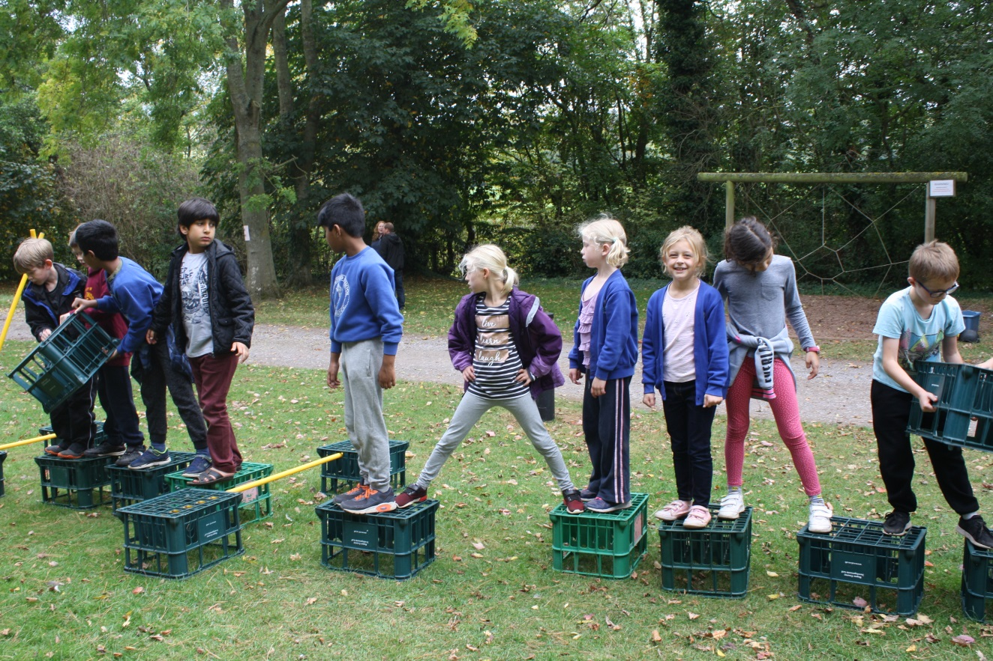
Team Building

Slide 15
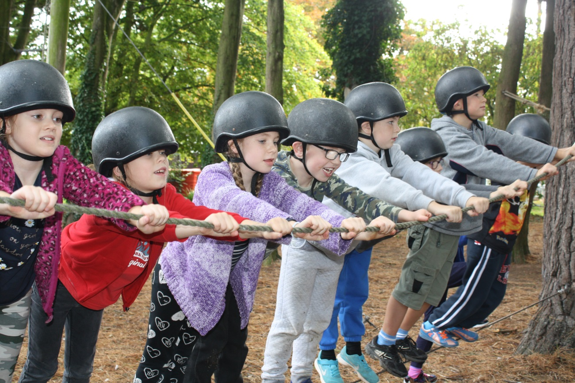
Working as a team

Slide 16
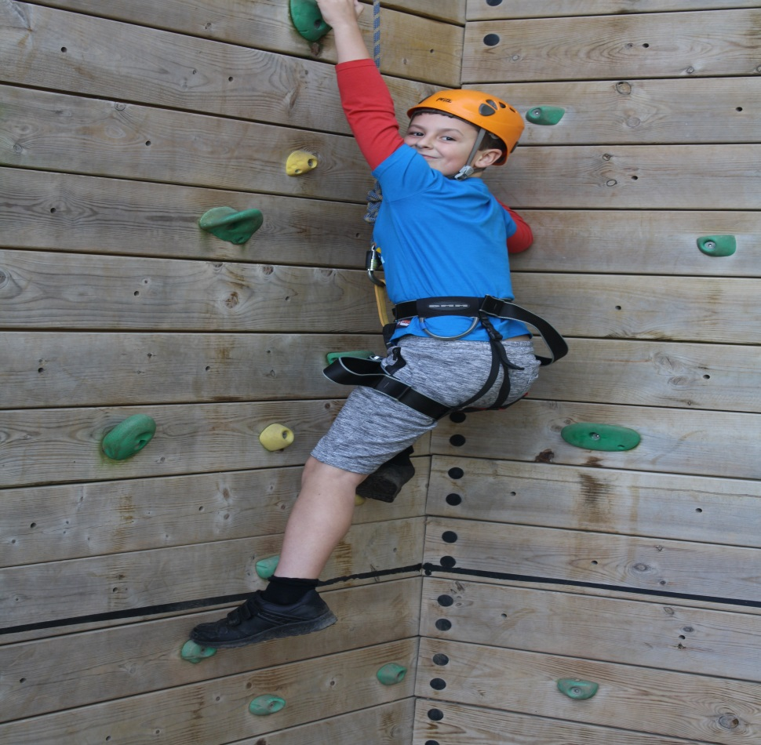
New Challenges

Slide 17
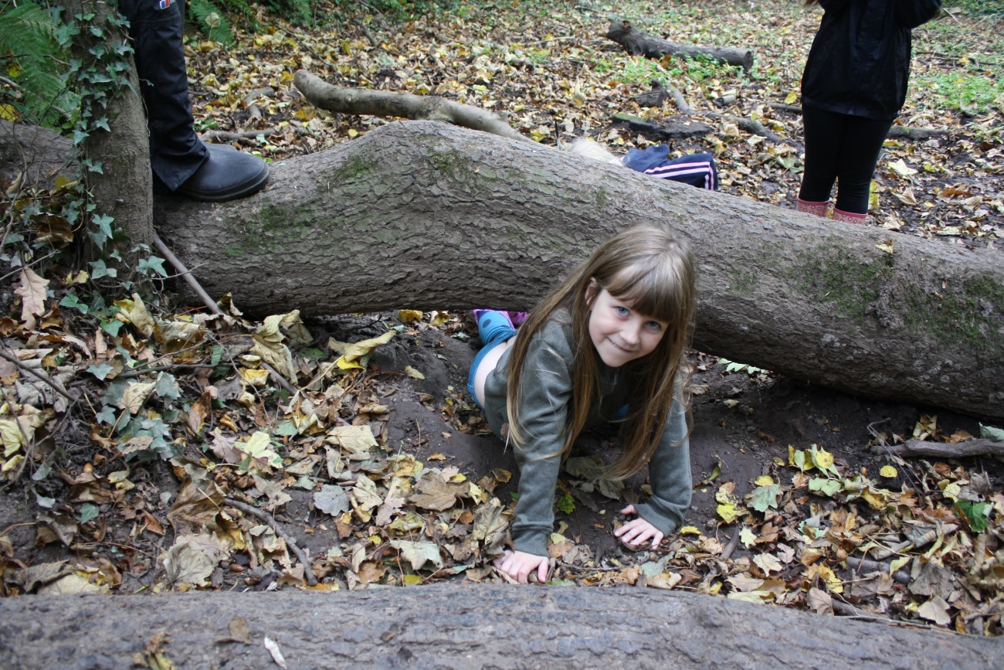
Following Instructions

Slide 18
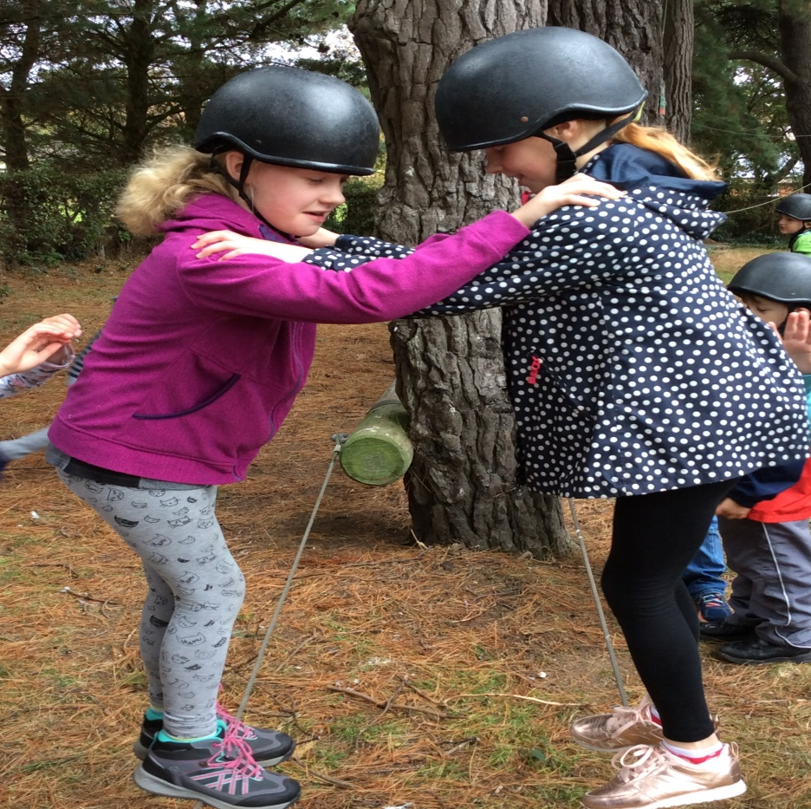
Trust

Slide 19
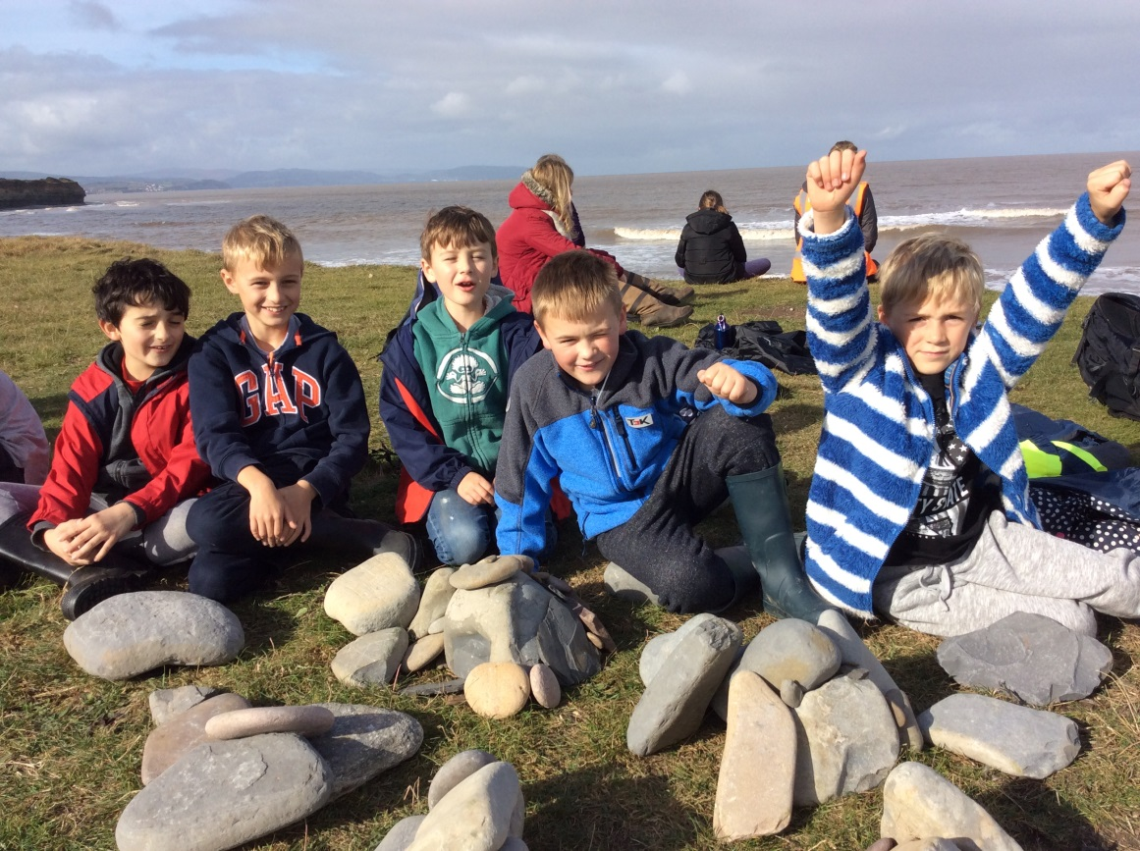
Fossil Hunting

Slide 20

Any Questions?

