Slide 1
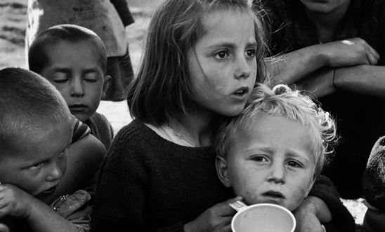
Families Together
Amnesty International UK

Slide 2
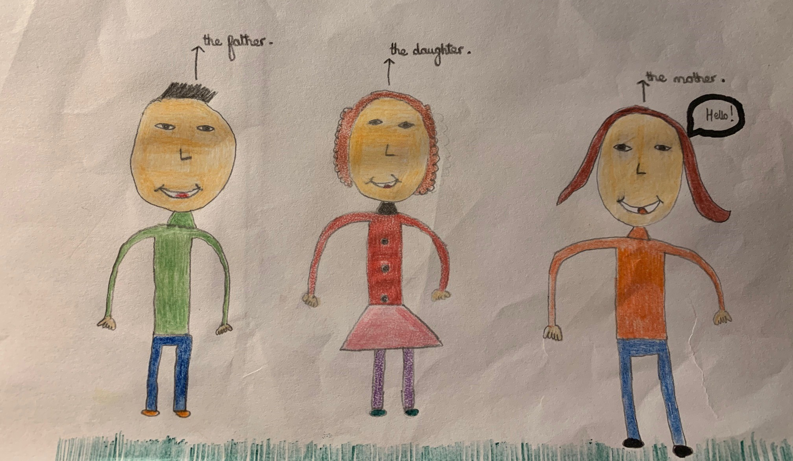
Amnesty International UK is part of a coalition of organisations asking for a change to the UK’s Immigration Rules
Taunton Amnesty International Group has signed up to that campaign.
We asked some local primary school children to help us.
They drew pictures of their family.
They have taken postcards to send to their MP.
We would like your help too…

Slide 3
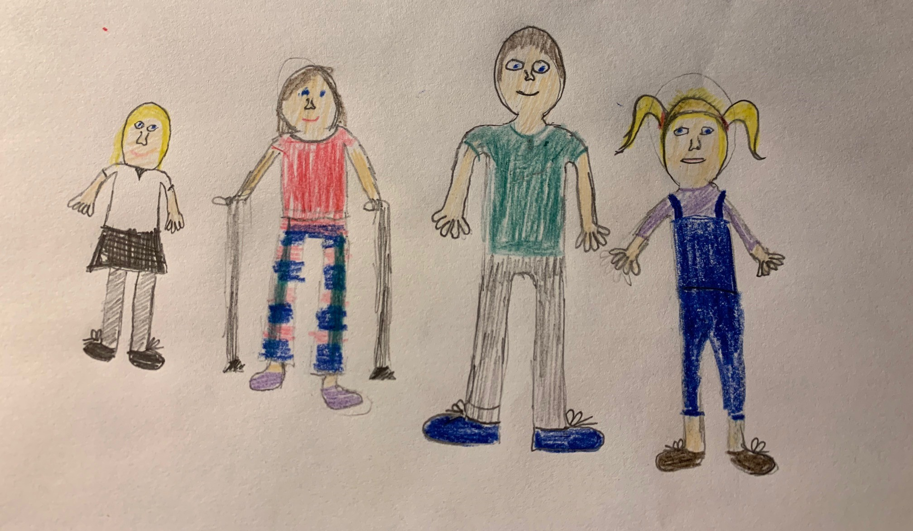
The Issue
If you are an adult refugee in the UK, you can ‘sponsor’ some of your family to join you. This is called Refugee Family Reunion.
If you are a child refugee, the immigration rules do not let you sponsor your family members.

Slide 4
The Law
In the UK, the Immigration Rules determine which refugees in the UK can sponsor family members to join them and which family members can be sponsored.
According to the rules, adult refugees in the UK can sponsor their partners, or their children provided they are under 18.
However, child refugees are explicitly excluded from this provision. Unaccompanied child refugees in the UK are excluded from the refugee reunion rules altogether. The policy guidance goes further and explicitly excludes children as eligible sponsors.
The Home Office has large discretion to grant family reunion outside the Immigration Rules… in practice applications outside the Immigration Rules are usually refused, although some of the refusals are overturned at appeal.
(Source: Without My Family The Impact of family Separation on child refugees in the UK by the Refugee Council, Save the Children and Amnesty International. Extracts from this report are reproduced throughout this display)

Slide 5
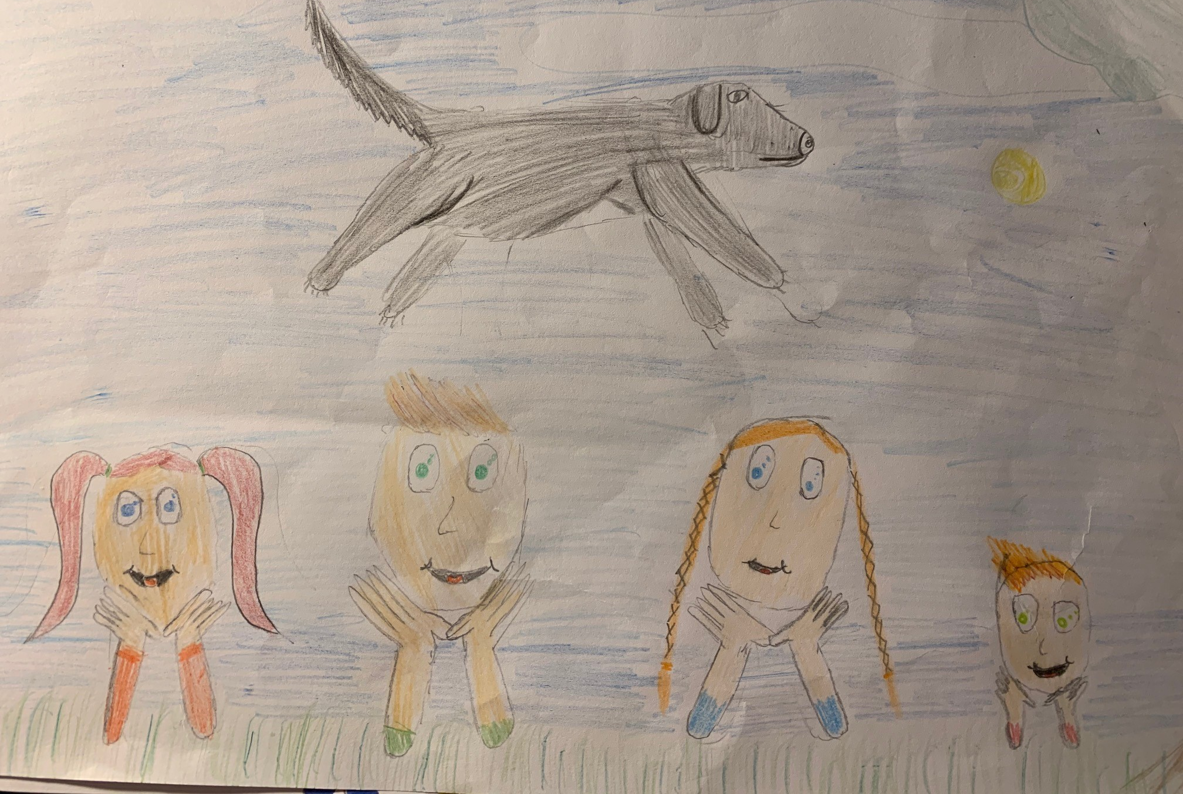
In all actions concerning children ‘the best interests of the child shall be a primary consideration’
Article 3, para 1 UN Convention on the Rights of the Child, (UNCRC)

Slide 6
The UK’s position puts it directly at odds with international law
The family is a protected concept under international human rights law, international humanitarian law, international refugee law and in regional legislation, and family reunion is mentioned in many international and regional legal instruments.
The Universal Declaration of Human Rights
Article 16(3): The family is the natural and fundamental group unit of society and is entitled to protection by society and the state.
Articles 17 and 23 of the 1966 International Covenant on Civil and Political Rights (ICCPR) establish that everyone has the right to family life and that it should be protected by society and the state.

Slide 7
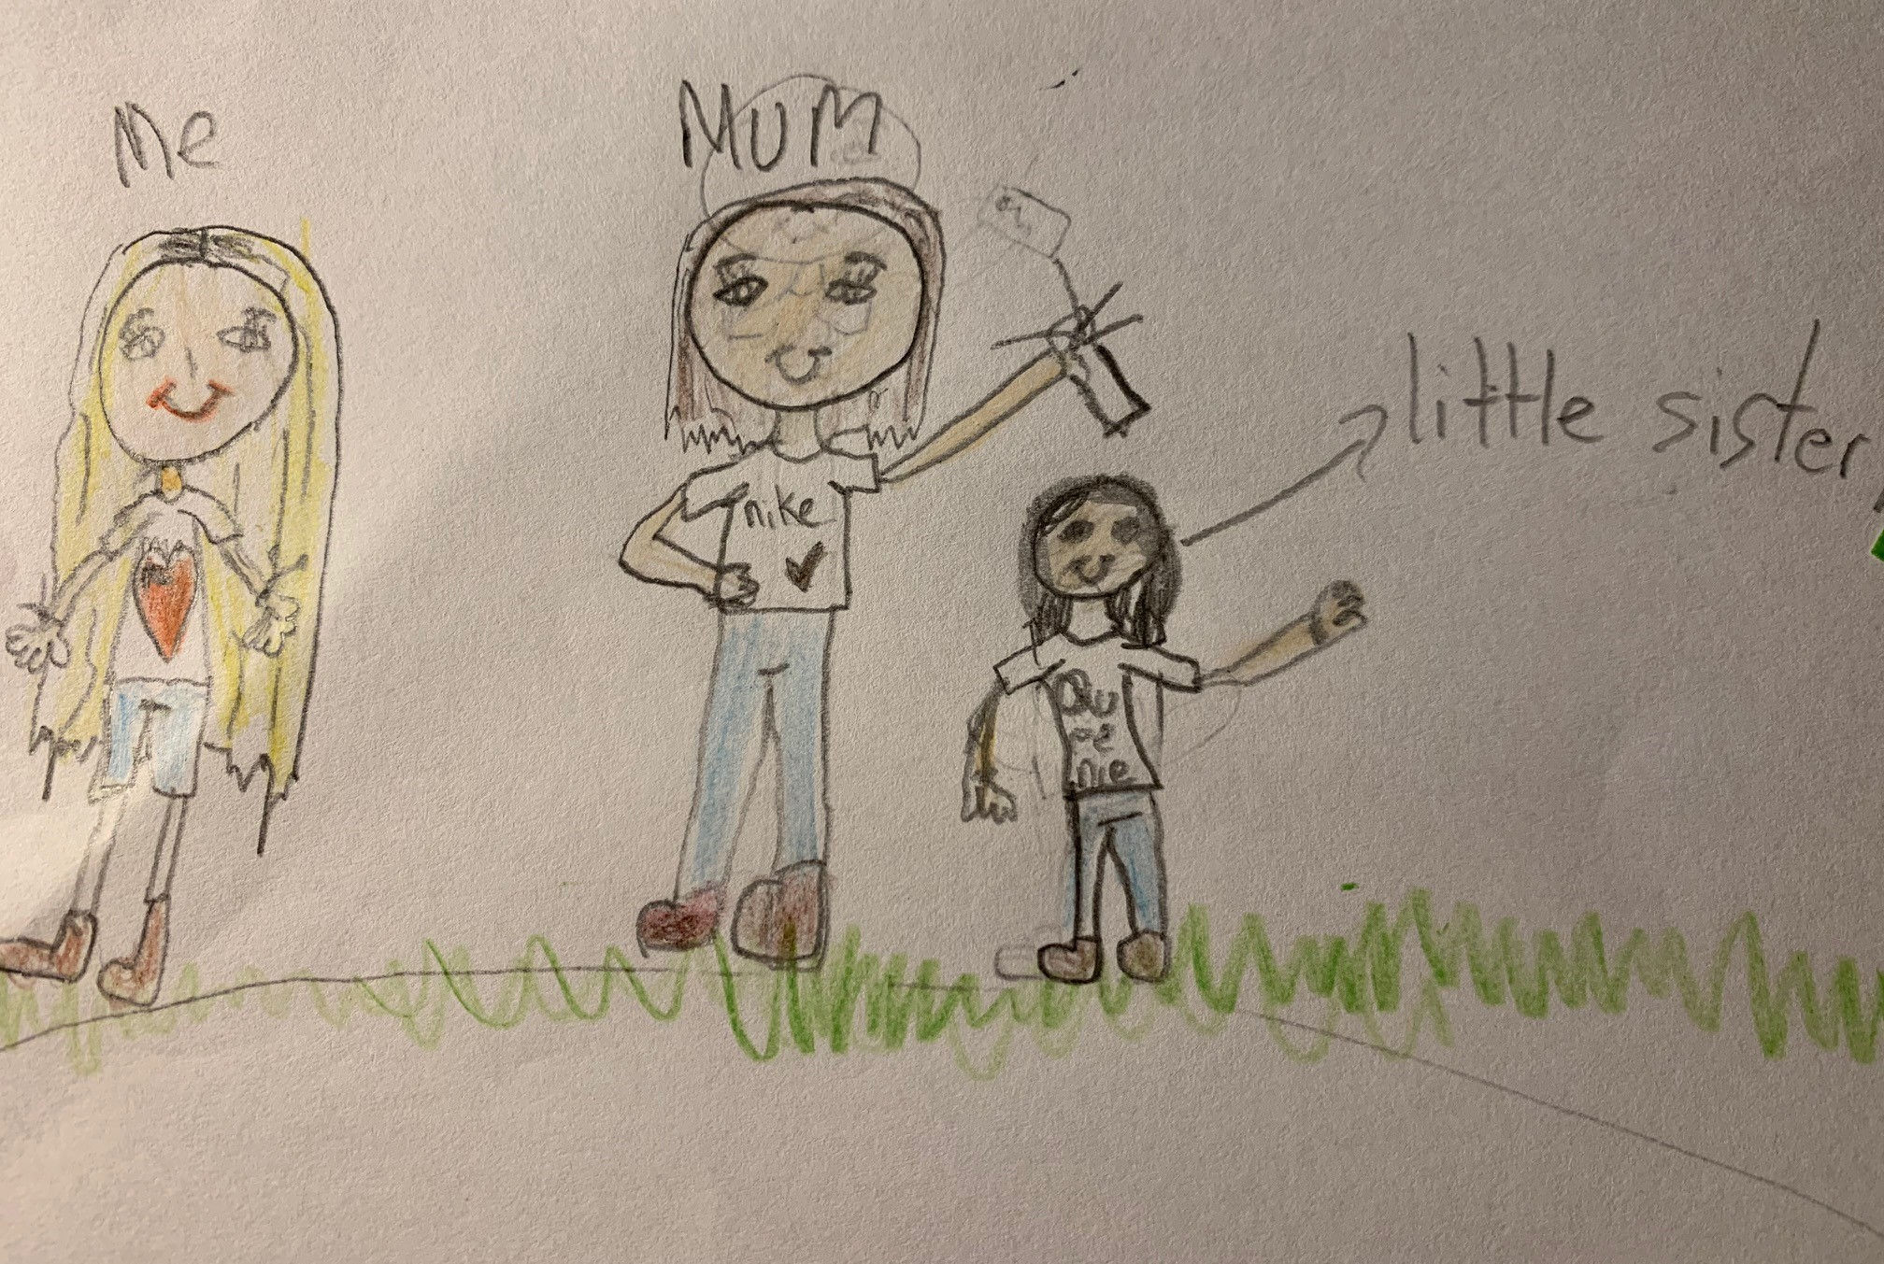
Articles 9 and 10 of the UNCRC also set out the right of children to be brought up by their family:
‘A child shall not be separated from his or her parents against their will, except when competent authorities subject to judicial review determine, in accordance with applicable law and procedures, that such separation is necessary for the best interest of the child’ (Article 9, para 1).

Slide 8
Article 3 of the 1989 UN Convention on the Rights of the Child requires that the child’s best interest are a primary consideration in all decisions affecting them.
This is given effect in UK law by section 55 of the Borders, Citizenship and Immigration Act 2009 (under which statutory guidance is issued). Section 55 requires that no other consideration can be treated as inherently more significant than the child’s best interests; where those best interests clearly favour a certain course of action, then very strong reasons are required not to follow it.
“As in so many cases involving children, there is no evidence that the statutory duty imposed by section 55(2) to have regard to the Secretary of State’s statutory guidance was discharged. I readily infer that it was not. This, sadly, seems to be the rule rather than the exception in cases of this kind”.
Mr Justice McCloskey then President of the Upper Tribunal (Immigration and Asylum Chamber) in AT and Another (Art 8 ECHR – Child Refugee – Family Reunification) Eritrea [2016] UKUT 00227(IAC)

Slide 9
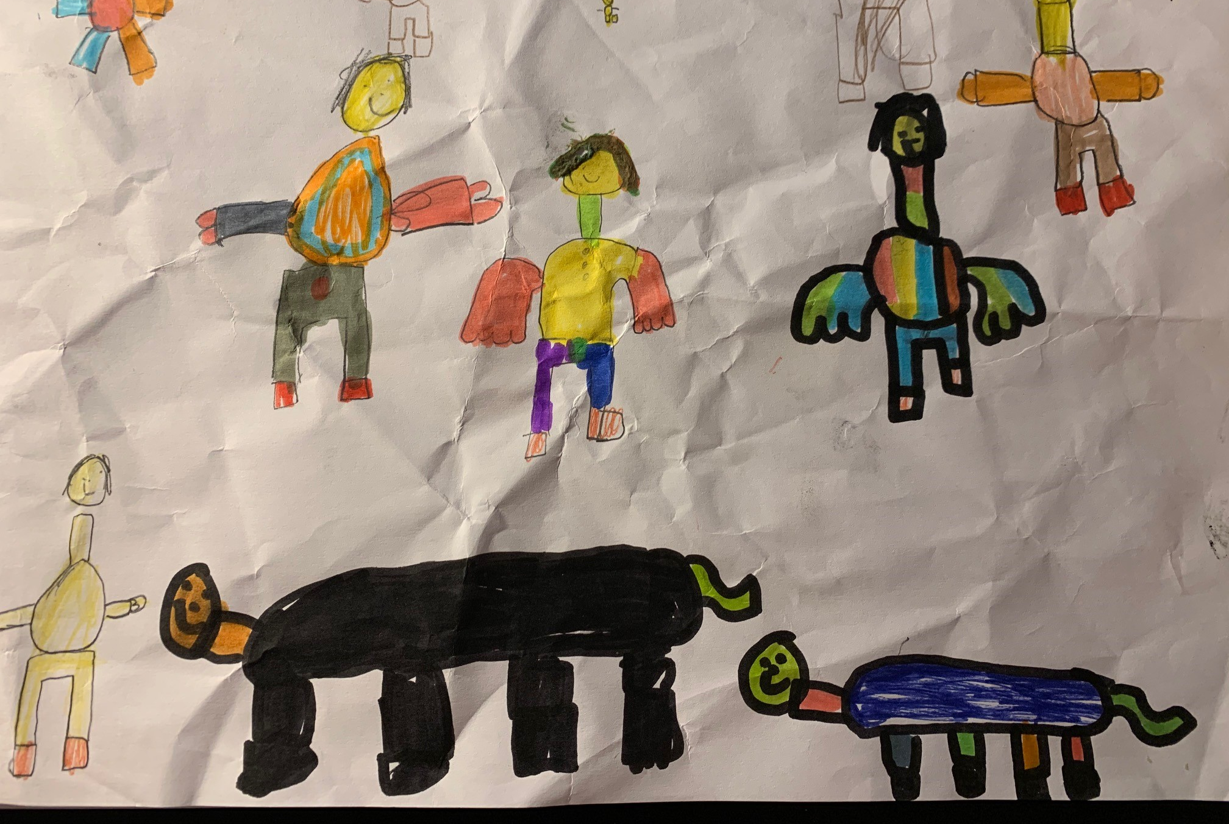
Article 10 UNCRC: In accordance with the obligation of State Parties under Article 9, Paragraph 1, applications by a child or his or her parents to enter or leave a State Party for the purpose of family reunification shall be dealt with by States Parties in a positive, humane and expeditious manner. States Parties shall further ensure that the submission of such a request shall entail no adverse consequences for the applicants and for the members of their family. (Article 10, para 1)

Slide 10
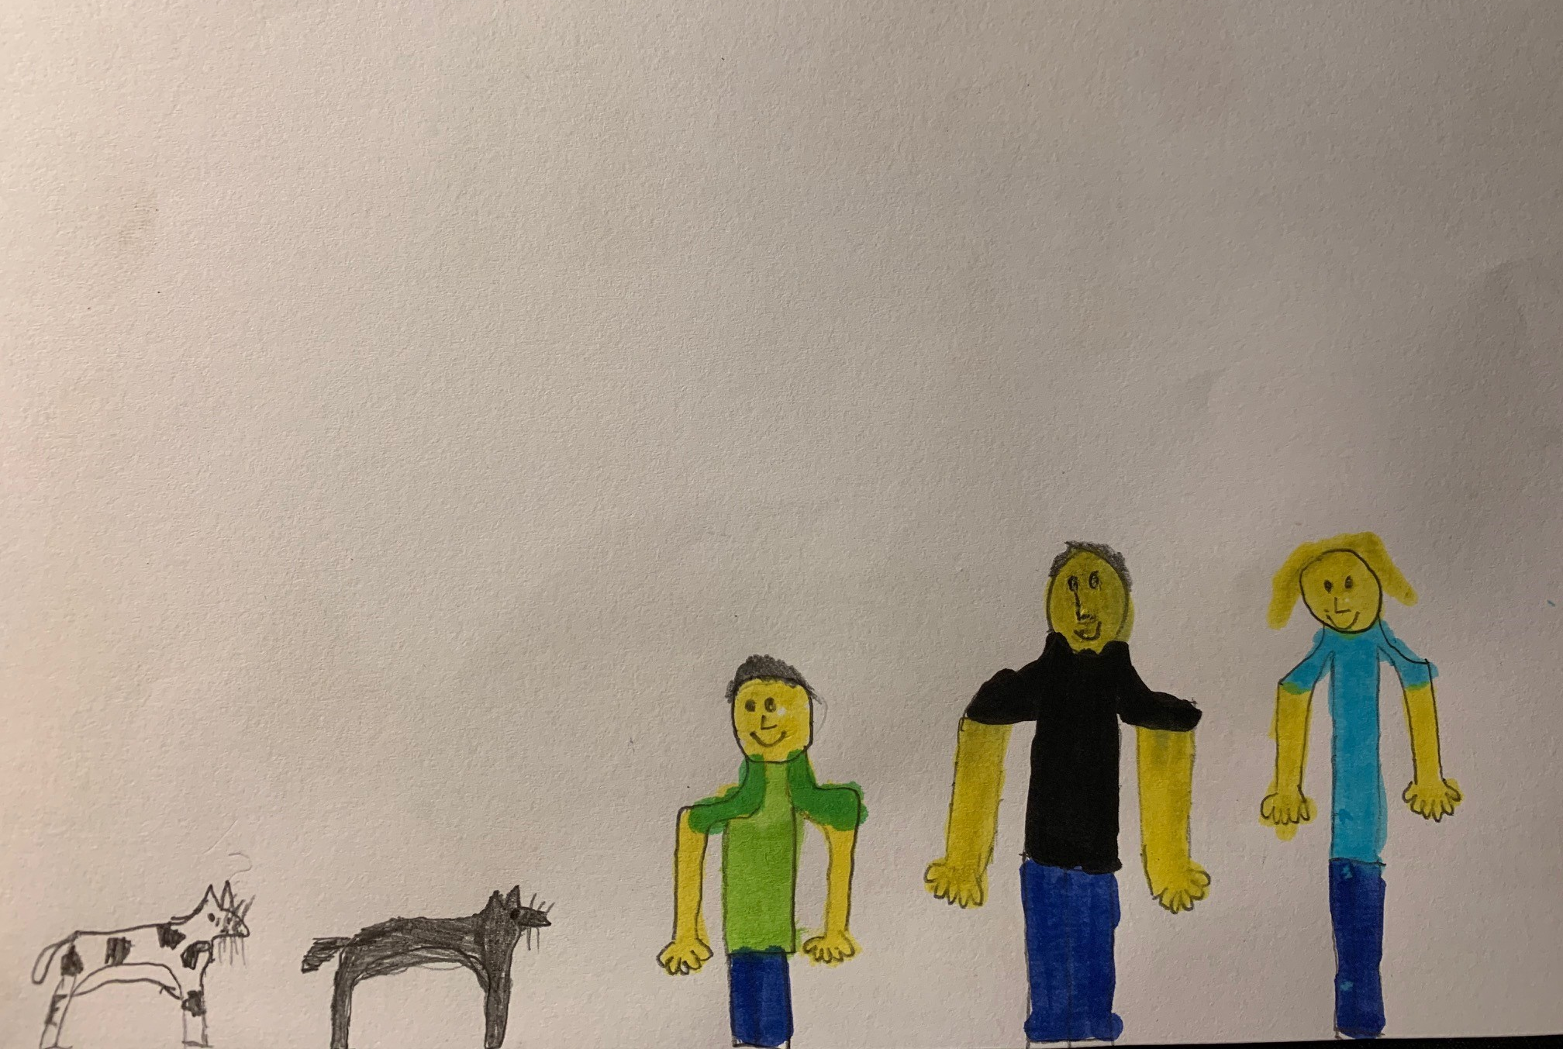
“We found no evidence to support the Government’s argument that the prospect of family reunification could encourage families to send children into Europe unaccompanied in order to act as an ‘anchor’ for other family members. If this were so, we would expect to see evidence of this happening in Member States that participate in the Family Reunification Directive. Instead, the evidence shows that some families are reluctant to seek family reunification, for fear that it may place family members in danger.”
(House of Lords Select Committee Inquiry on unaccompanied minors in the EU (2016).

Slide 11
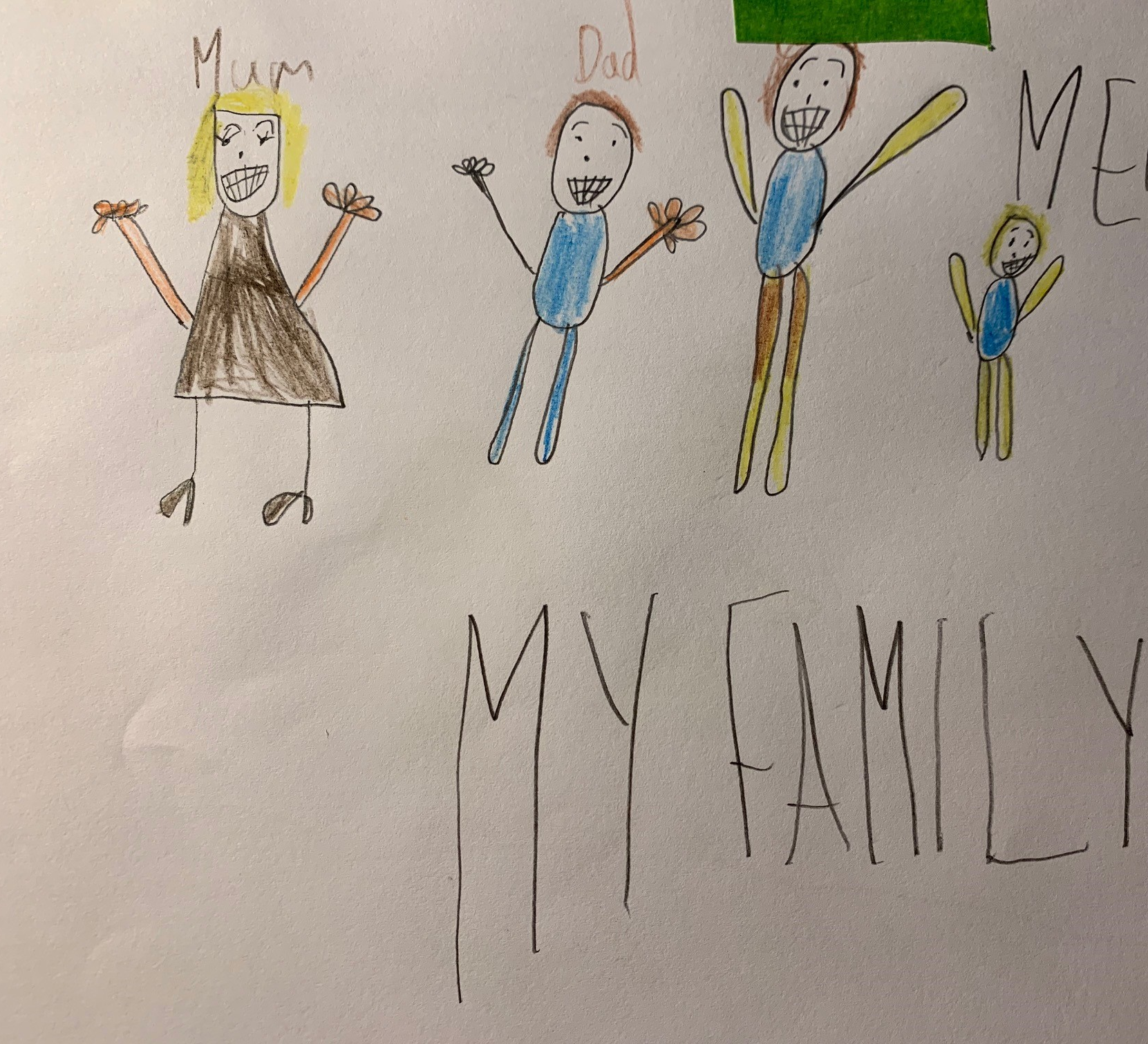
‘It seems to us perverse that children who have been granted refugee status in the UK are not then allowed to bring their close family to join them in the same way as an adult would be able to do. The right to live safely with family should apply to child refugees just as it does to adults.’
(House of Commons, Home Affairs Select Committee, July 2016)

Slide 12
Ask your MP and the Home Secretary to take action!
Write to the Home Office asking that they:
1. Permit the right to family reunion for unaccompanied children with international protection needs when this is in their best interests. This right should be formalised within the Immigration Rules for those with Humanitarian Protection status as well as for those recognized as refugees.
2. Ensure that family reunion rights are made accessible to former unaccompanied child refugees who are now over 18 years of age.
3. Commit to a broad enough definition of family for unaccompanied child refugees to enjoy their right to family life and to include child siblings and any legal or customary care givers in their country of origin.

Slide 13

More Information:
https://www.familiestogether.uk/
Taunton Amnesty International Group
https://www.amnesty.org.uk
https://www.amnestytaunton.com
Find us on Facebook and Twitter

