Slide 2
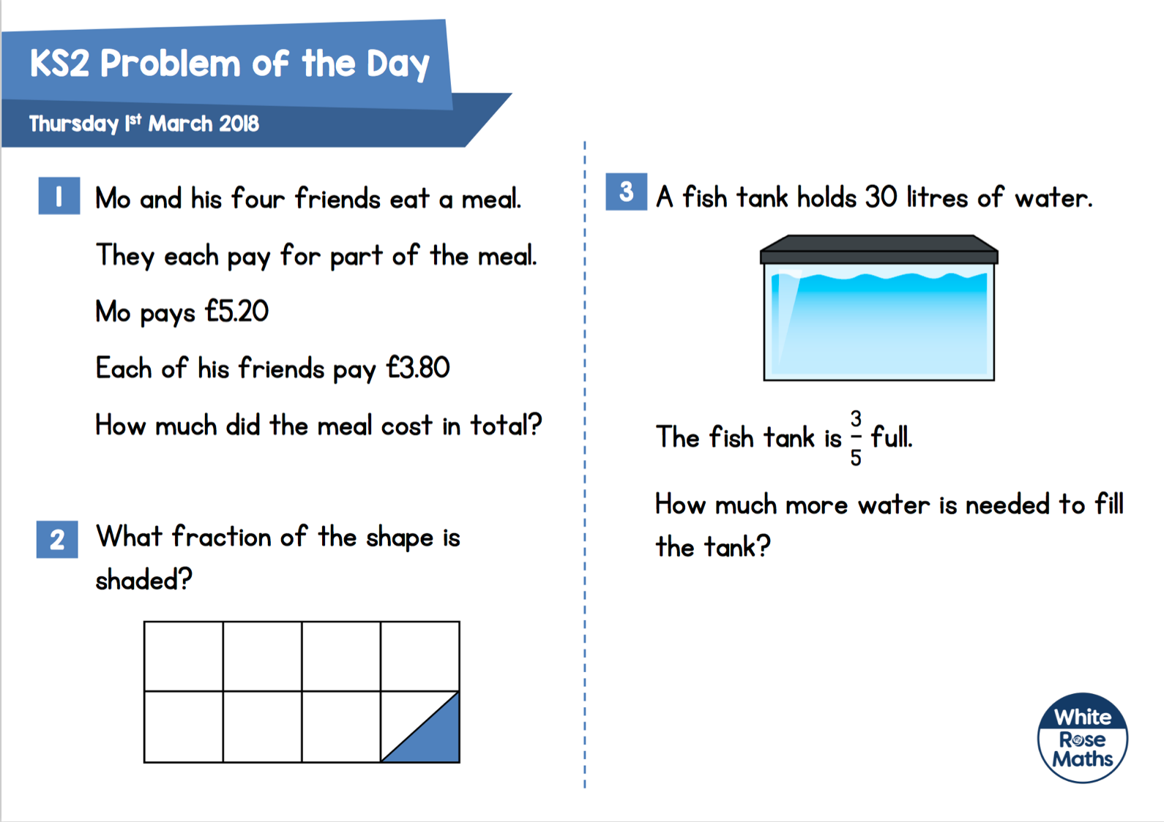
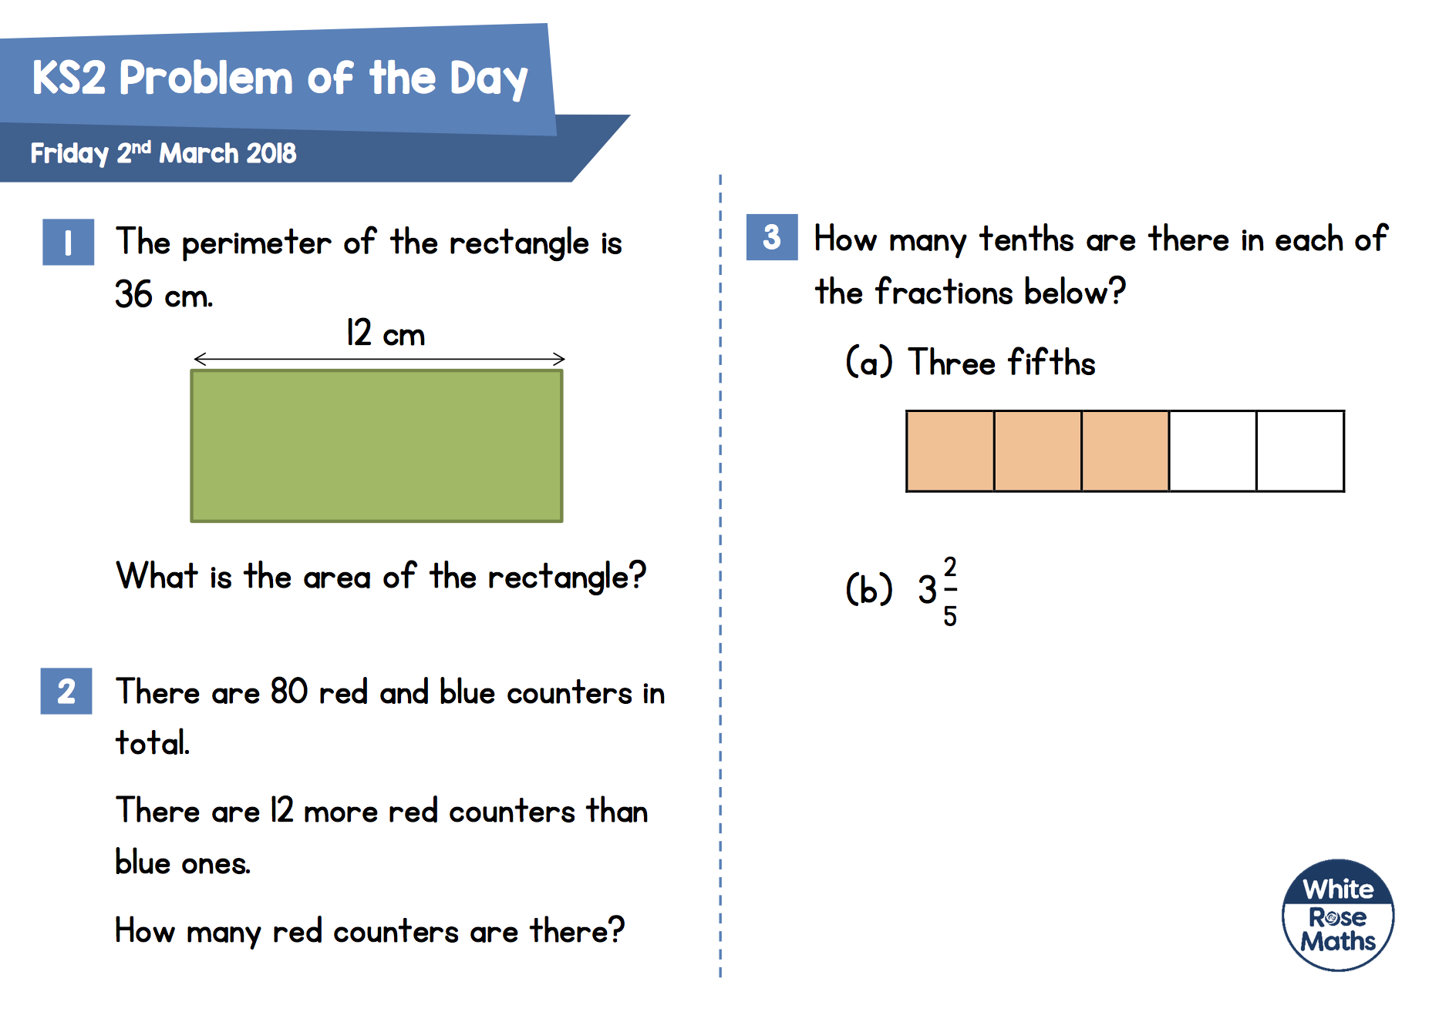
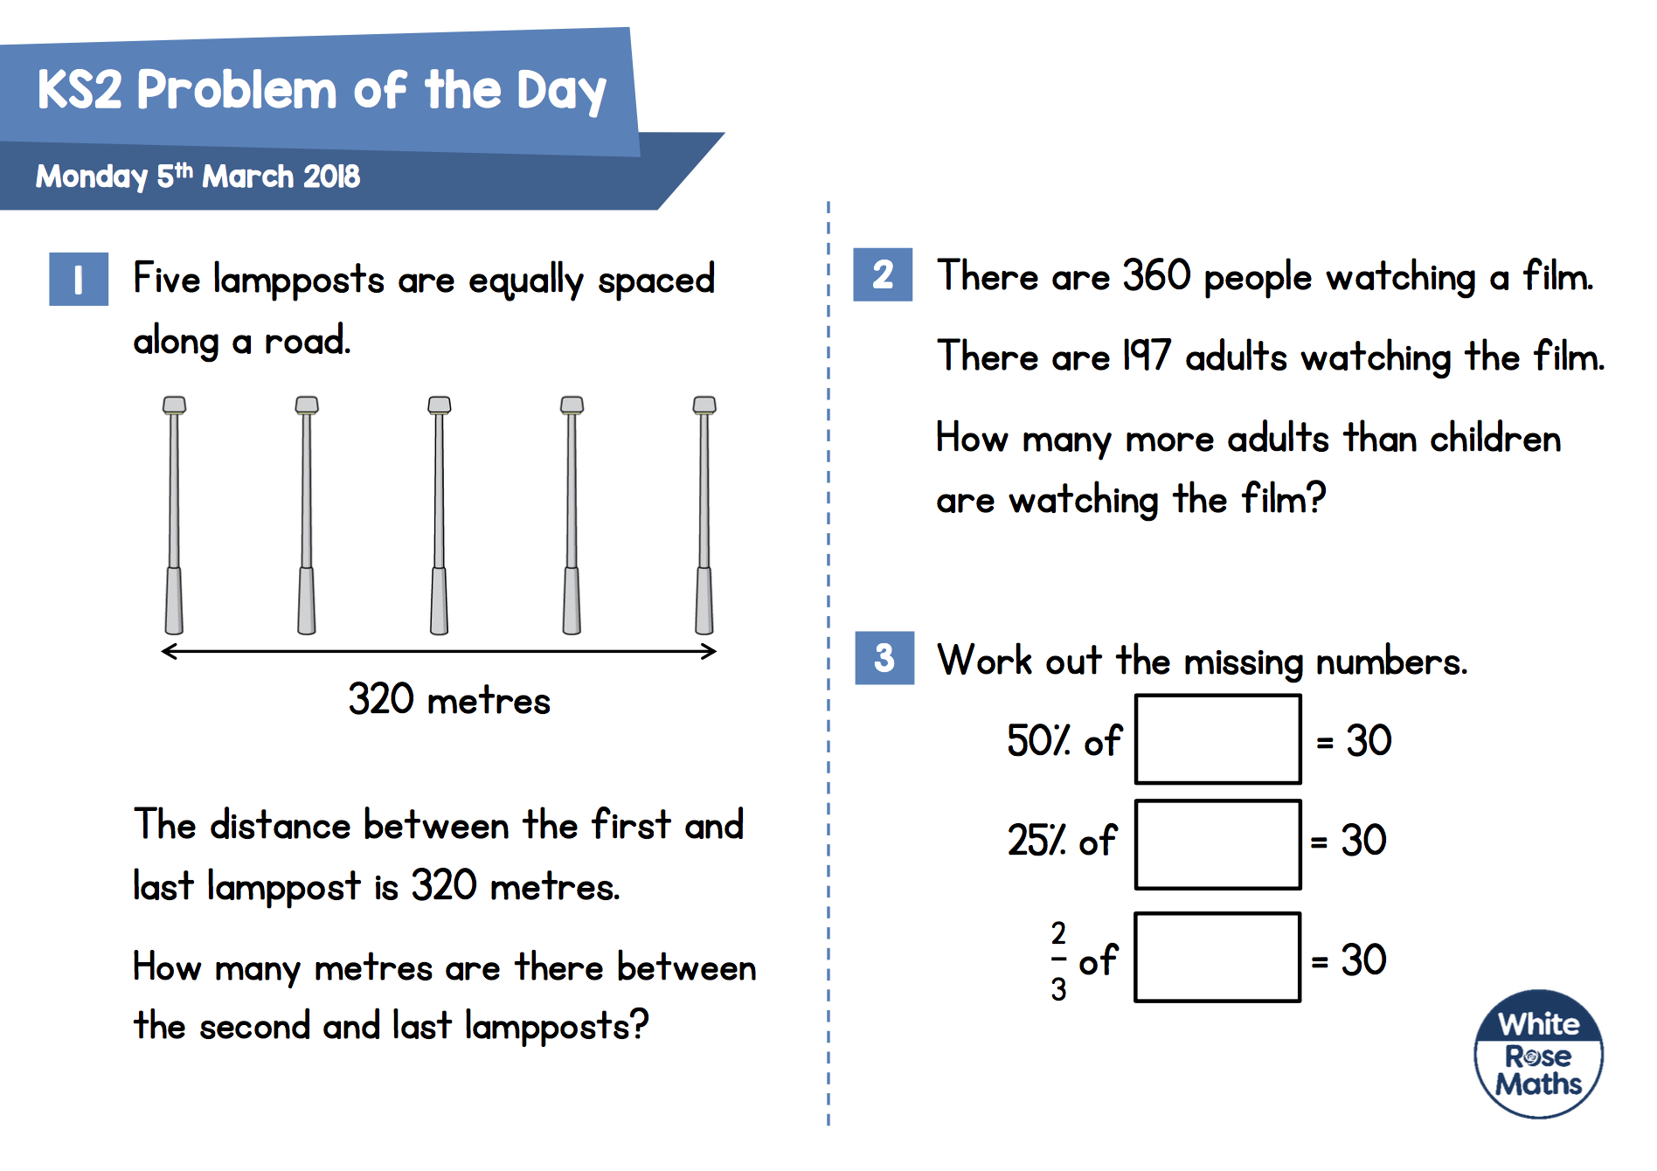
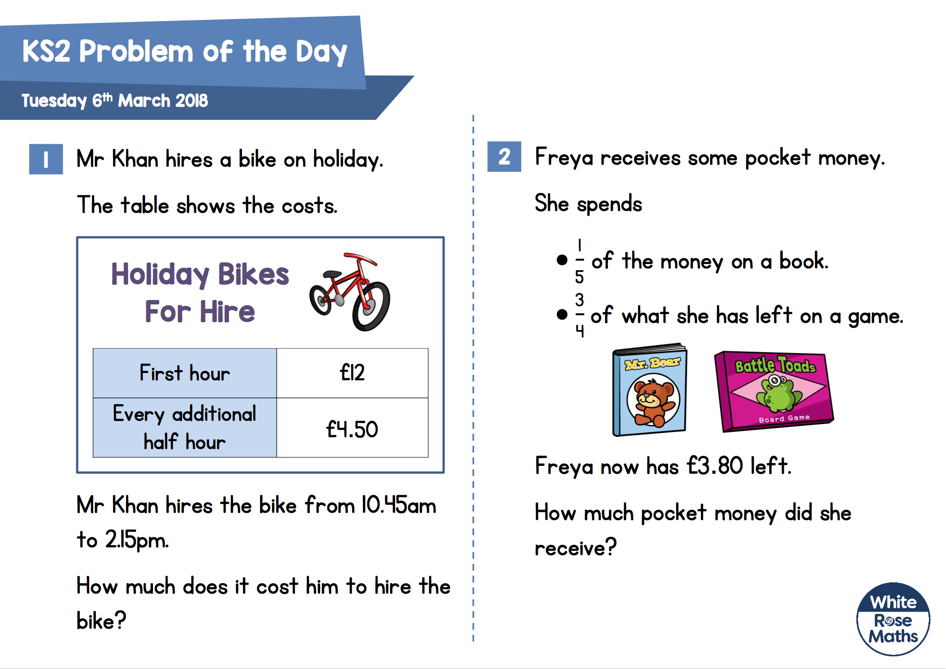
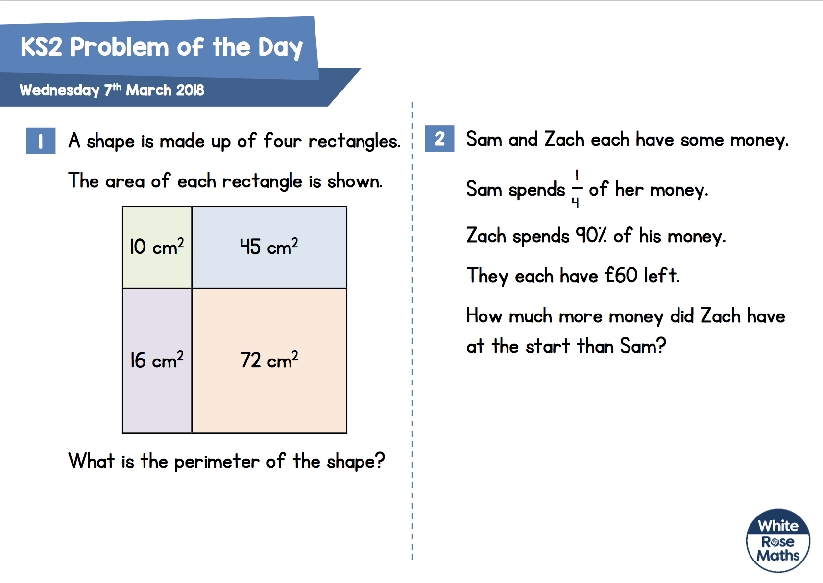
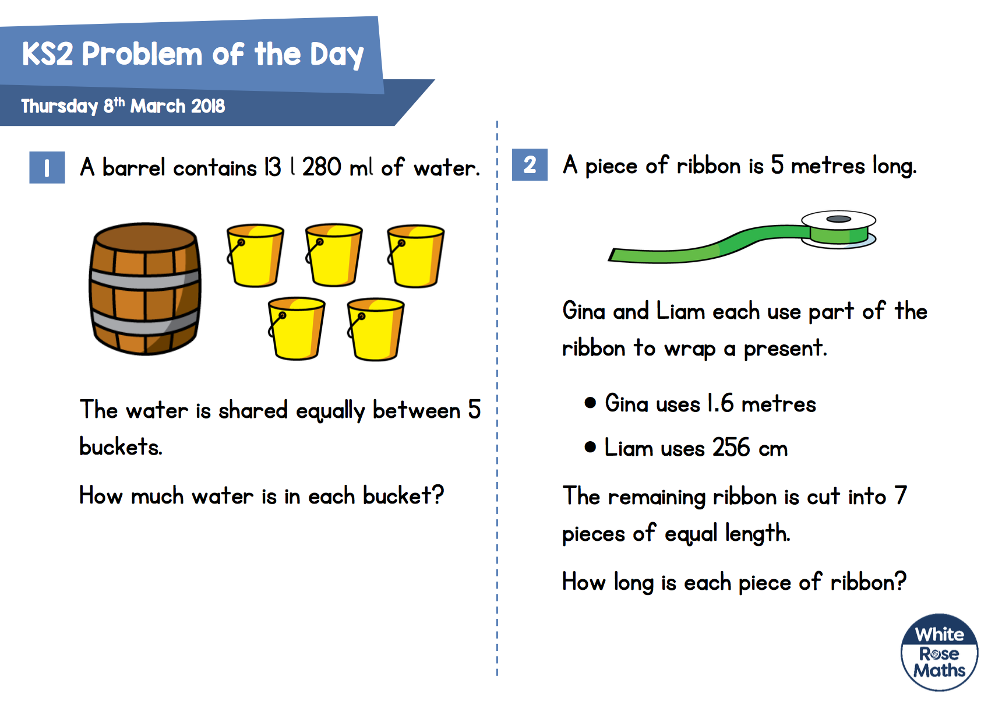
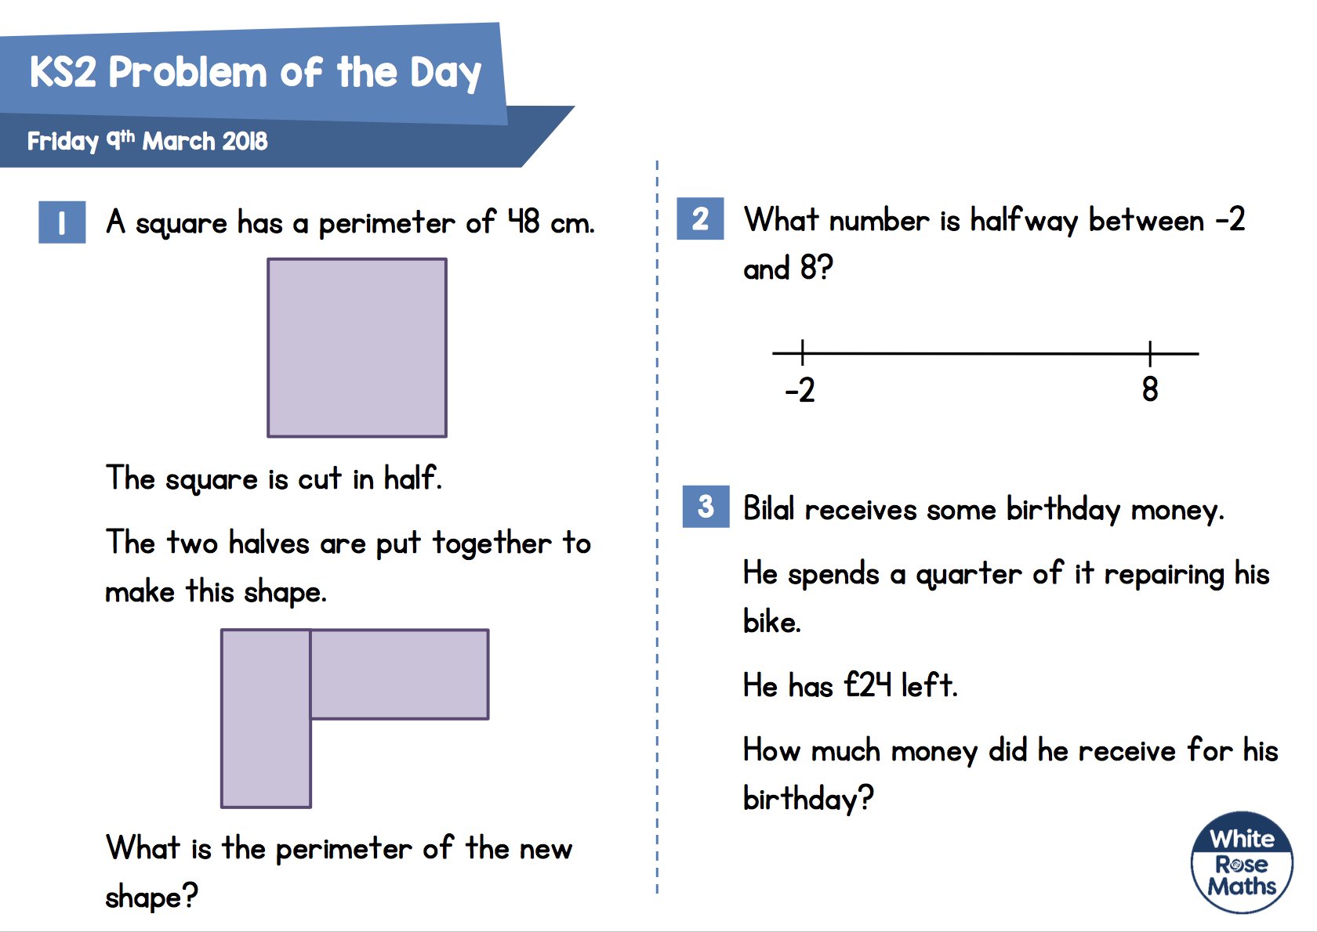
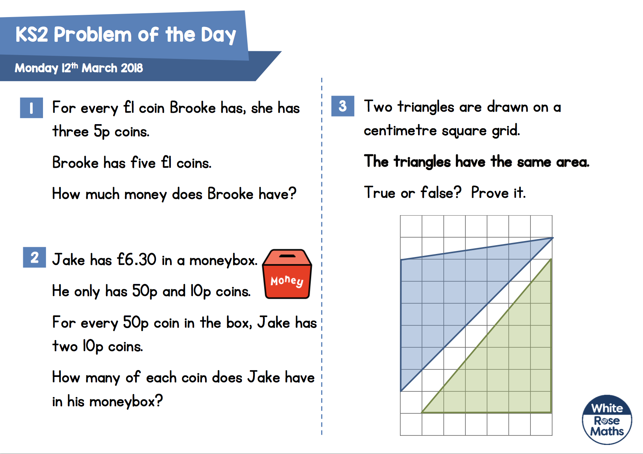
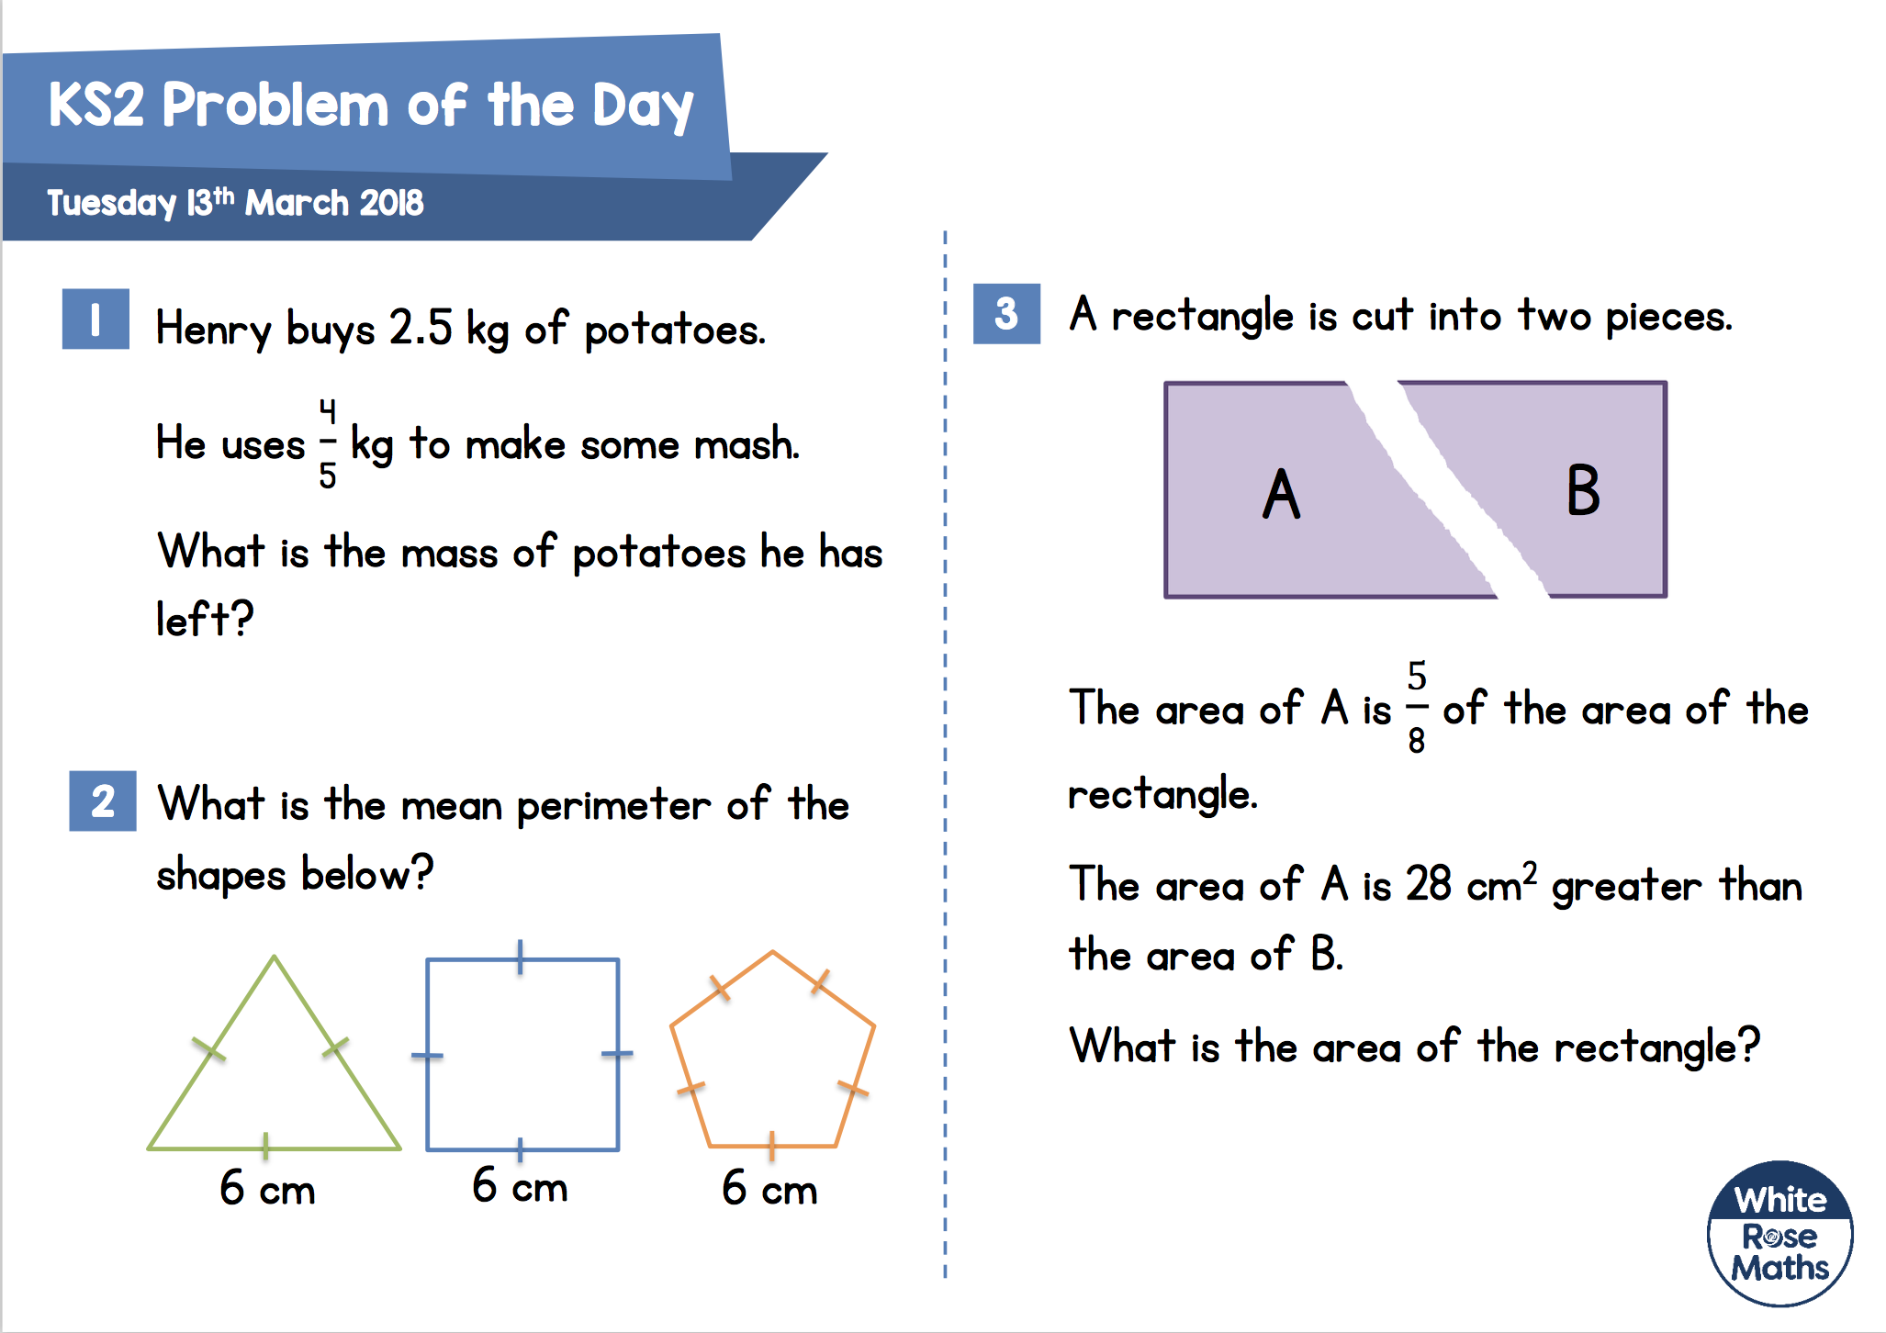
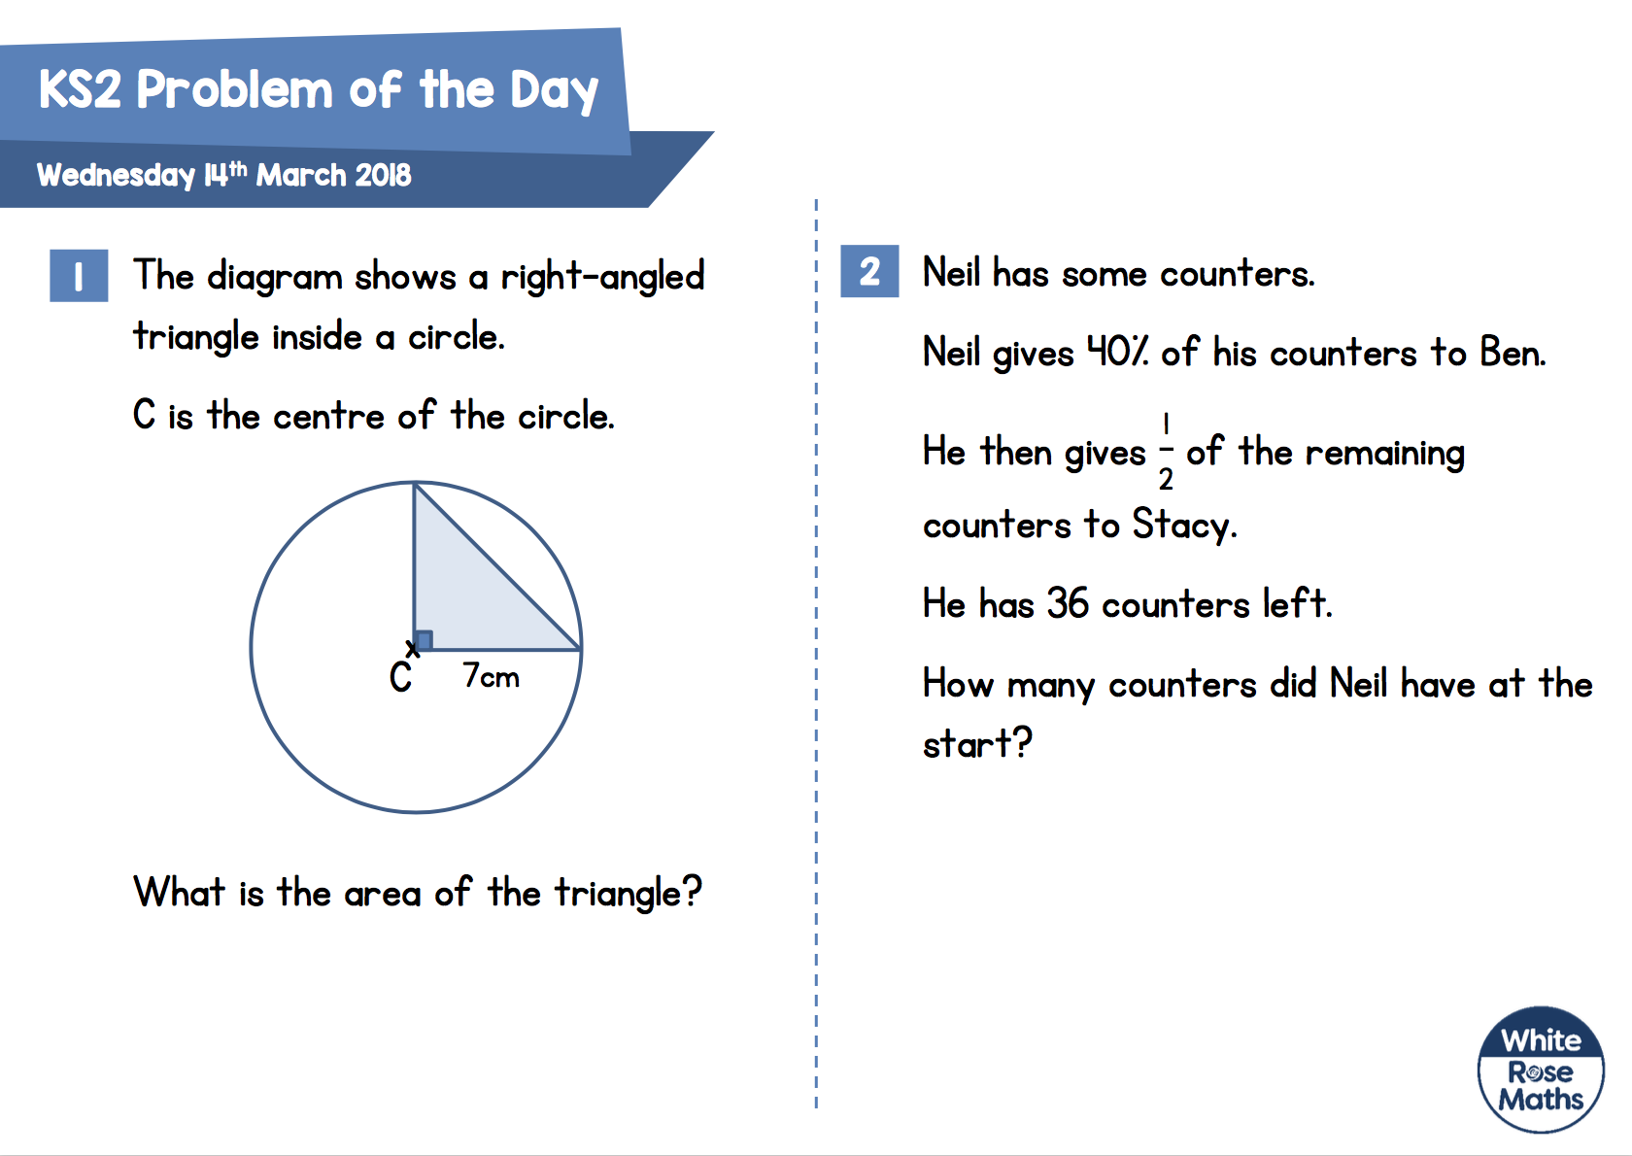
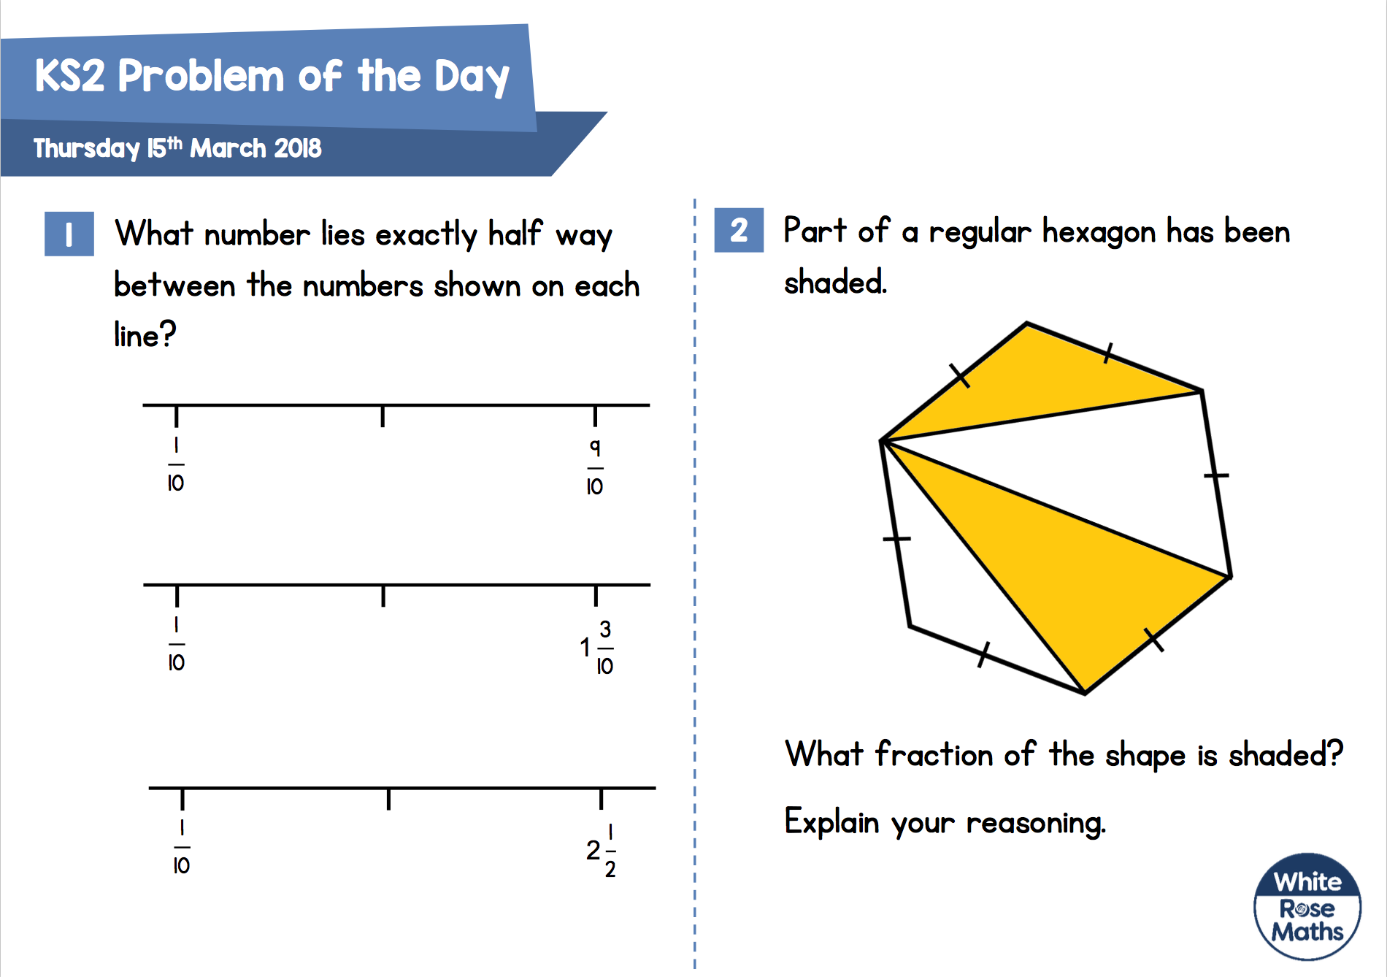
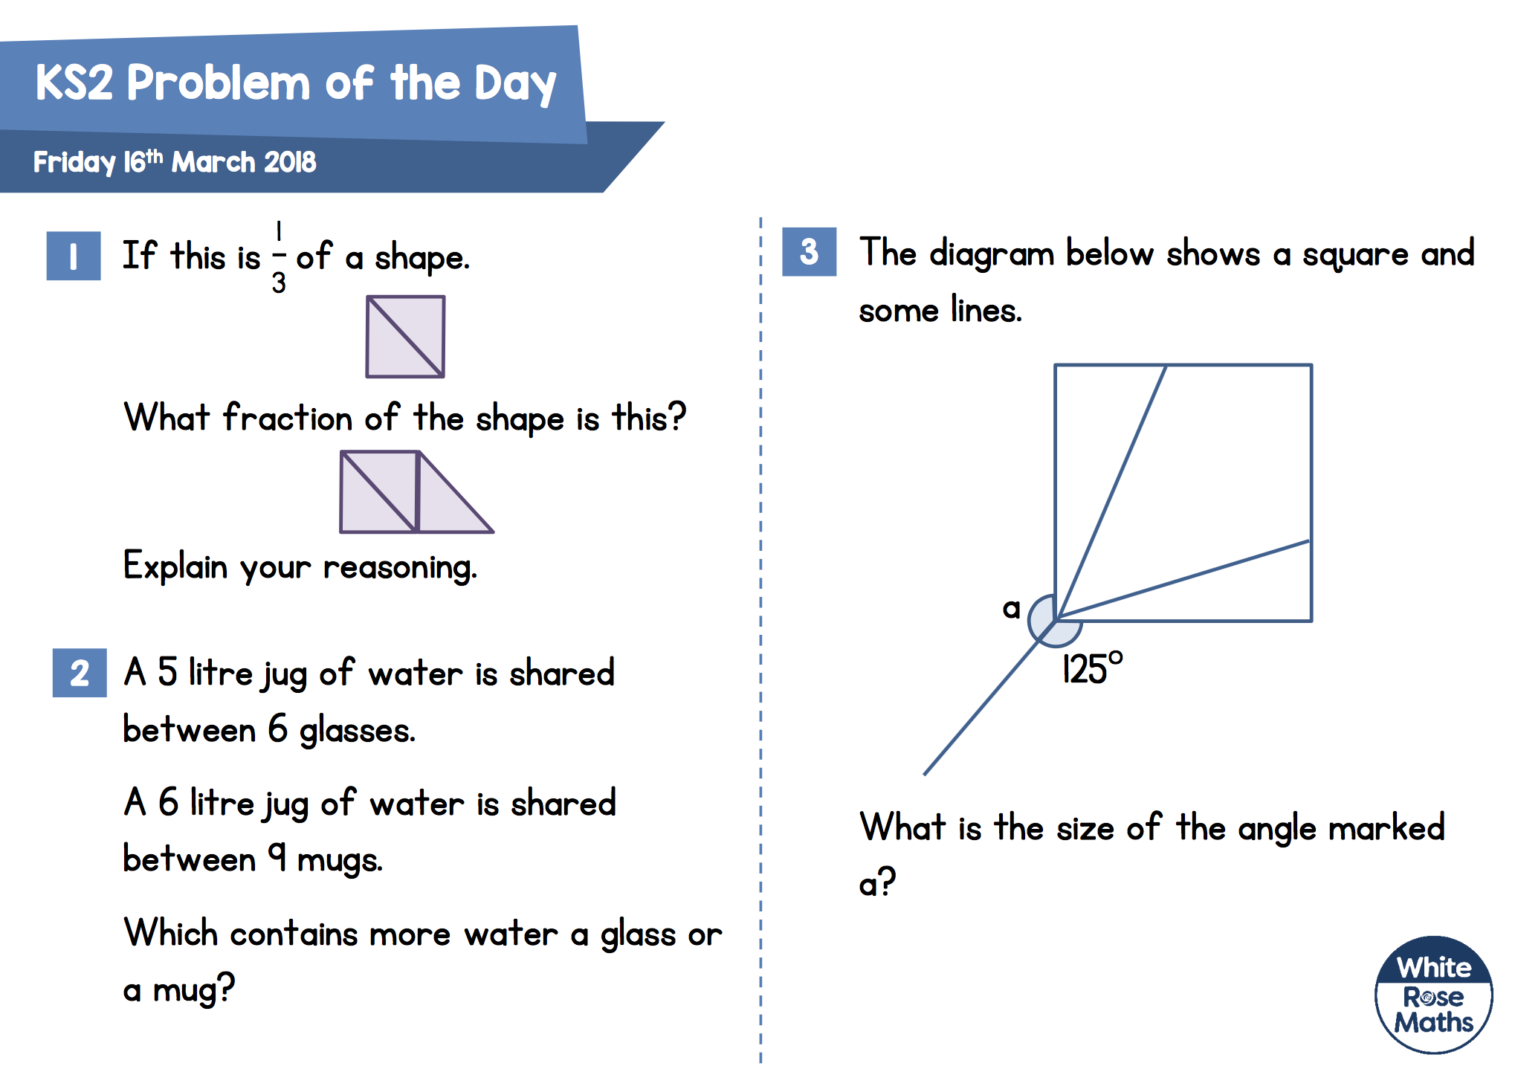
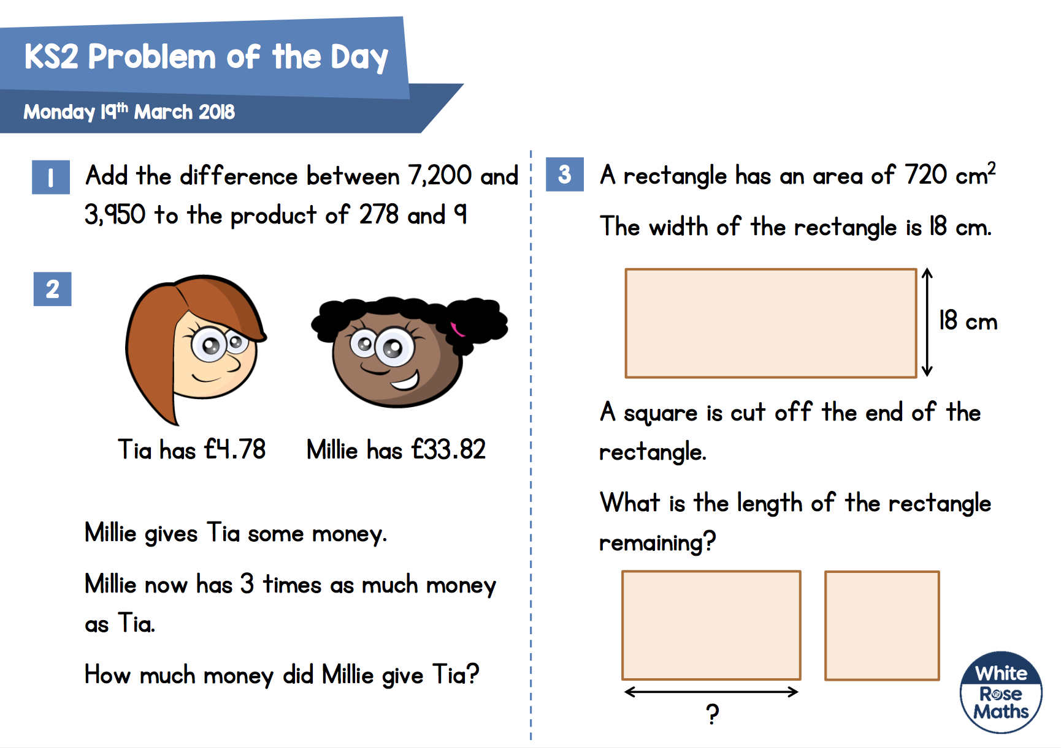
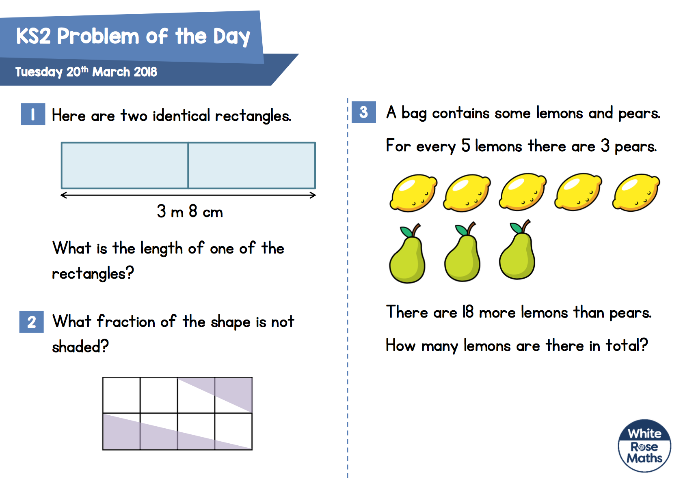
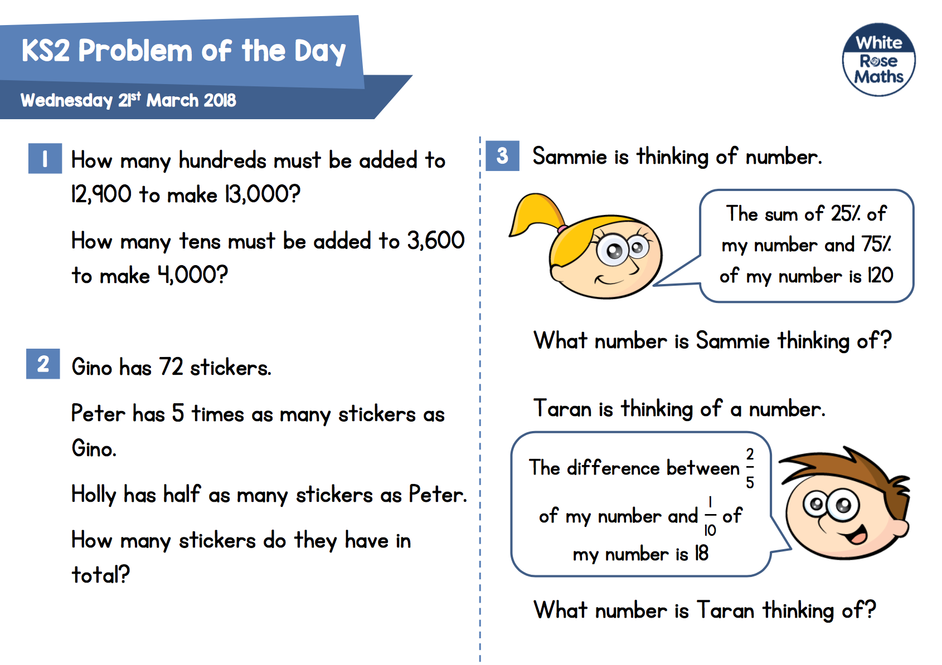
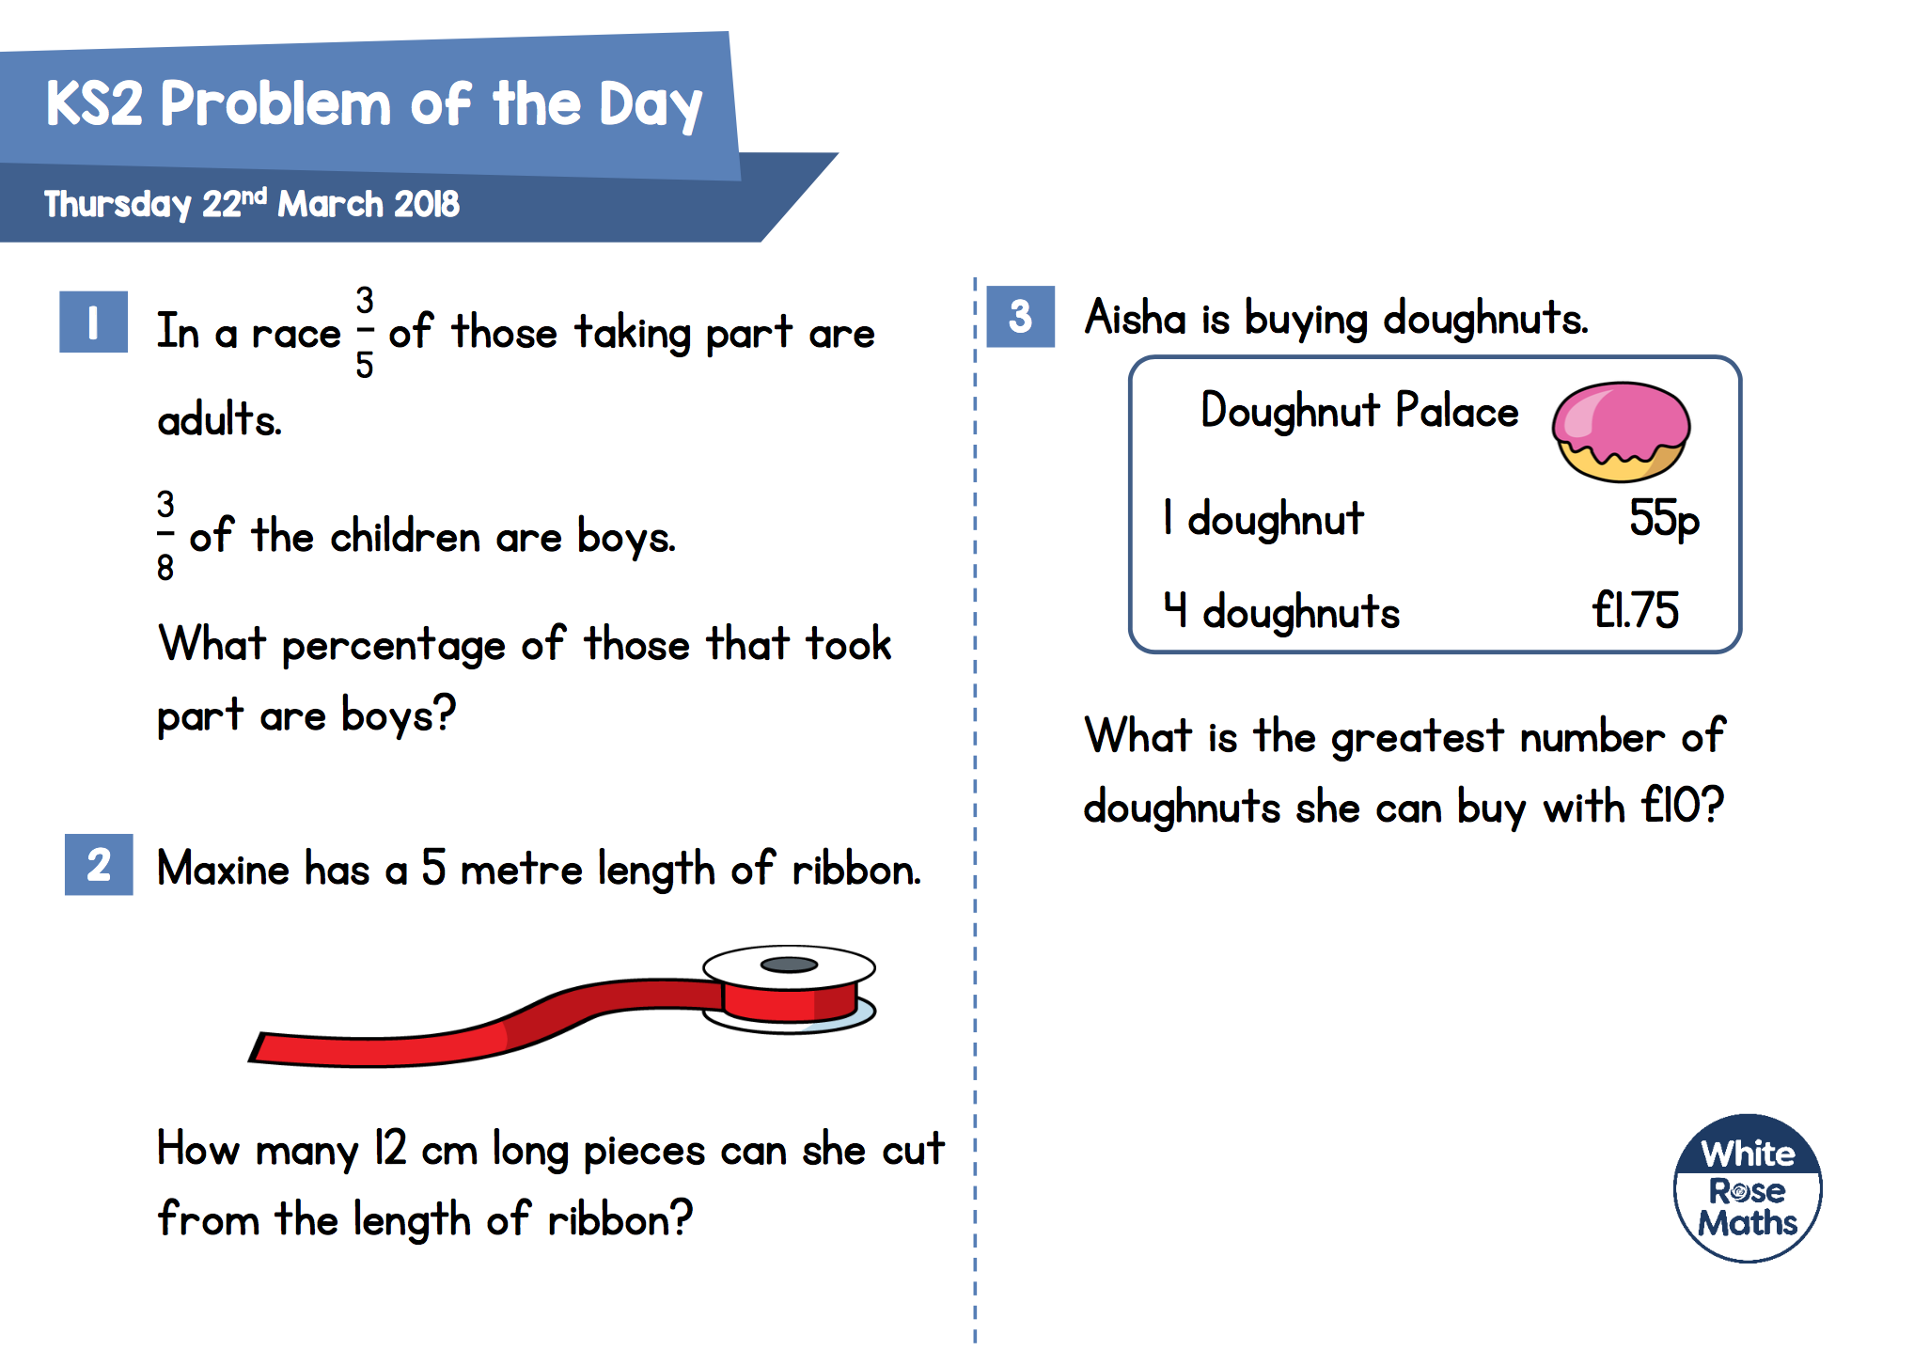
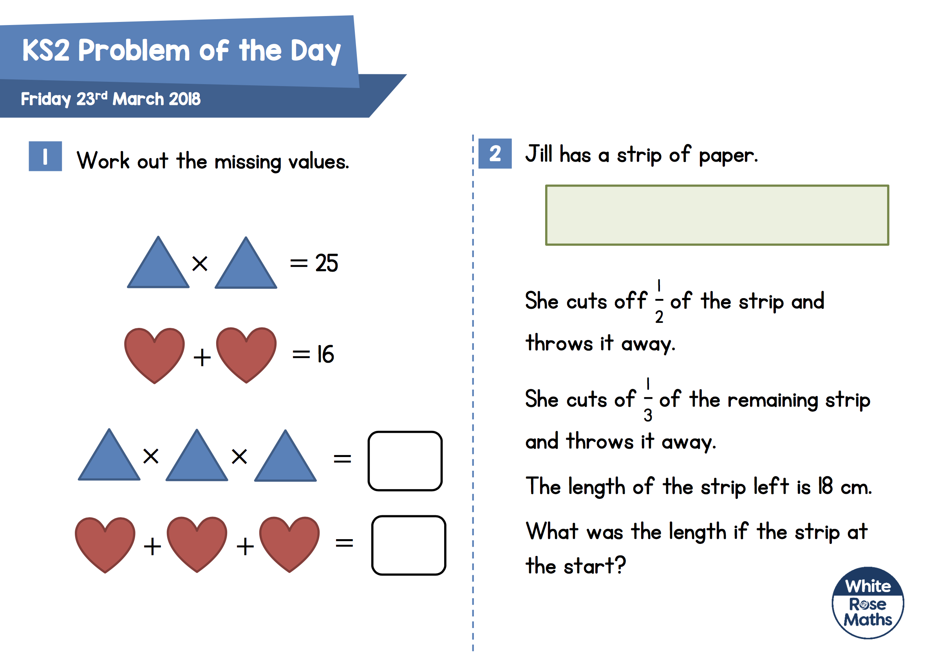
March Problems of the Day
Key Stage 2
Monday | Tuesday | Wednesday | Thursday | Friday | Saturday | Sunday
 |  |  | 1 | 2 | 3 | 4
5 | 6 | 7 | 8 | 9 | 10 | 11
12 | 13 | 14 | 15 | 16 | 17 | 18
19 | 20 | 21 | 22 | 23 | 24 | 25
26 | 27 | 28 | 29 | 30 | 31

Slide 3
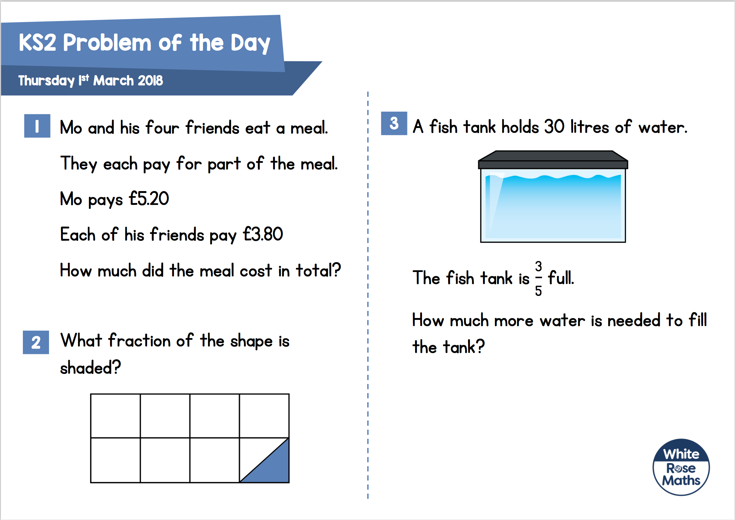

£20.40
12 litres
$$\frac{\text{1}}{\text{16}}$$

Slide 4



$$\frac{\text{6}}{\text{10}}$$
$$\frac{\text{34}}{\text{10}}$$
72 ${cm}^{2}$
46

Slide 5
34
60
120
45
240 m

Slide 6
£19
£34.50

Slide 7
5 cm
8 cm
£520
2 cm
9 cm
48 cm

Slide 8
2 l 656 ml
12 cm

Slide 9
3
£32
60 cm

Slide 10
£5.75
True – both have an area of 21 cm²
9 50p coins
18 10p coins

Slide 11
1.7 kg
112 cm²
24 cm

Slide 12
24.5 cm²
120

Slide 13




$\frac{1}{2}$
$\frac{7}{10}$
$\frac{1}{2}$
$1\frac{3}{10}$

Slide 14

$\frac{1}{2}$
145°
A glass holds more water.

Slide 15
5,752
£4.87
22 cm

Slide 16

1 m 54 cm
$\frac{5}{8}$
45

Slide 17
1
40
120
612
60

Slide 18
15%
22
41

Slide 19
125
24
54 cm

