Slide 1

Year 5 Curriculum Evening
2024

Slide 2
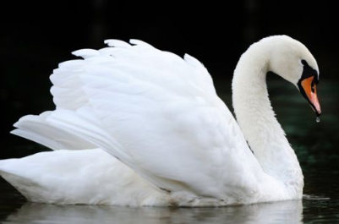
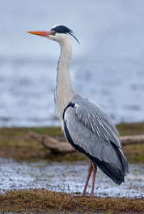
Meet the team!
Mrs Swarbrick – Swan class teacher
Miss Kneller – Heron class teacher
LSA’s
Miss Jones – Swan Class
Mrs Edney - Heron Class

Slide 3
Structure of the day…
8:50-9:00 Registration/morning task
9:00-11:00 Morning session
11:00 -11:15 Break time
11:15 - 12:10 Mid morning session
12:10-1:10 Lunch - Year 5 eat first
1:10- 3:30 Afternoon session
Monday morning - KS2 assembly Mr Jones
Tuesday - year group/class assembly
Wednesday morning – KS2 singing assembly
Friday morning - Celebration assembly

Slide 4
What does my child need to bring to school?
Daily
Reading record (signed)
Reading book
Weekly
Homework given out on FRIDAYS.
Please return by the following FRIDAY.
Spelling test every FRIDAY.
Fortnightly
Times table book

Slide 5




Slide 6

English

Slide 7
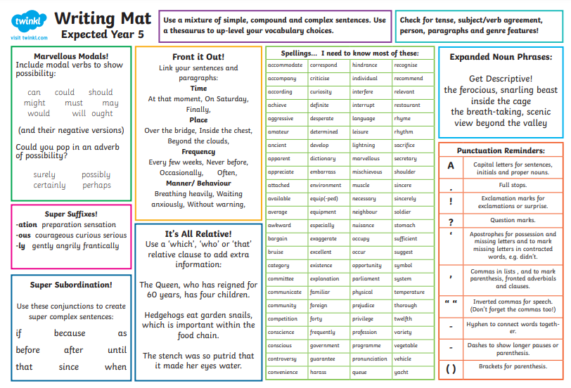

Slide 8
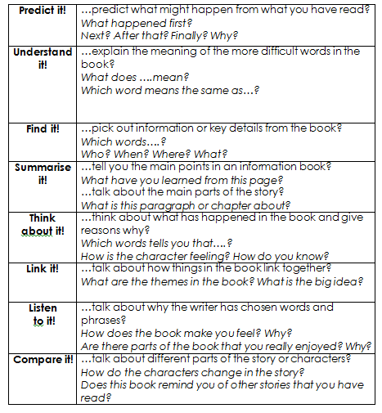
Reading
In upper key stage 2, we teach two whole class guided reading sessions each week.
Children will focus on the following strands: vocabulary, retrieval, inference; summarizing; predicting; identifying/explaining how information/narrative content is related and contributes to the meaning as a whole; identifying and explaining how meaning is enhanced through choice of words and phrases and making comparisons within the text
They are also taught how to answer questions in a test.

Slide 9
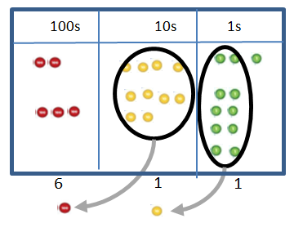
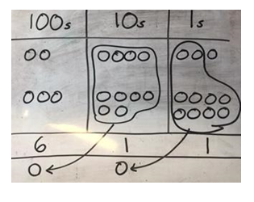

Maths
Concrete
Pictorial
Abstract

Slide 10
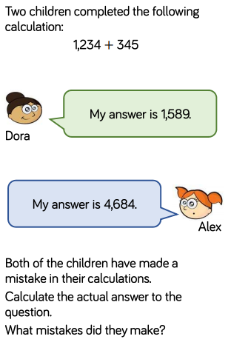

Problem solving & reasoning…

Slide 11
Personal, Social, Health and Economic (PSHE) education
PSHE education became statutory for all schools from September 2020.
This Programme of Study sets out learning opportunities based on three core themes:
Health and wellbeing
How can I stay mentally and physically well?
What happens when I grow and change?
Relationships
Why are families and friendships so important?
How do we respect ourselves and others?
What do safe relationships mean?
Living in the wider world
What does it mean to belong to a community?
What is media literacy and digital resilience?
How can I be a global citizen?
Why does money and work matter?

Slide 12
PE
Your child will be taught P.E on a Thursday am.
Please wear PE kits to school.
Please name all uniform.
Avoid jewellery and wrist bands.
Swimming – Friday mornings 10:30 leave school
Herons swim from September to February Half term
Swans swim from February half term to the end of the year.

Slide 13
Homework expectations
Daily: Ten-fifteen minutes of reading every night
Weekly:
Spellings: 15 - 20 words
Maths: CGP books (30 minutes)
English: CGP books Grammar or Punctuation activity (30 minutes)
Fortnightly: Learn/practise a times table
Half termly: Homework menu (complete a minimum of 2)
(Topic, Online Safety, Values, Rights Respecting School and Activity Passport)
Additional activities: Times Tables Rockstars

Slide 14
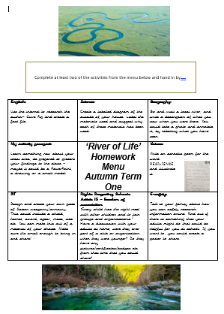
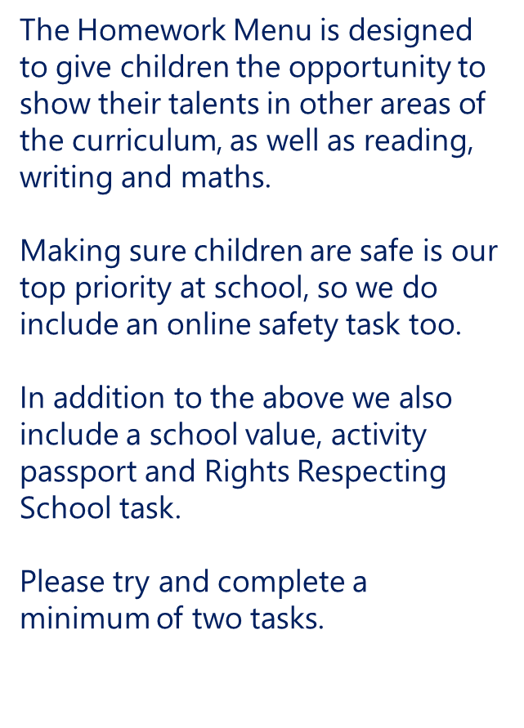

Slide 15


Slide 16
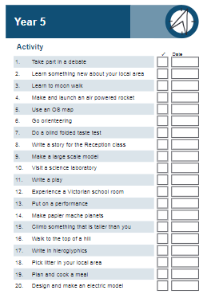


Slide 17
Year group page
https://www.parkfieldschool.co.uk/year-5-3/

Slide 18
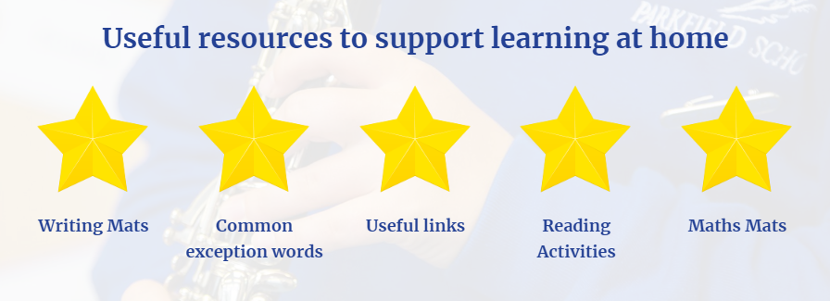
How can I support my child at home?

Slide 19






Slide 20
Contact details
Mrs Swarbrick: swan@parkfieldschool.co.uk
Miss Kneller: heron@parkfieldschool.co.uk

Slide 21

Any questions?

