Slide 1

Year 4 Curriculum Evening
2022

Slide 2
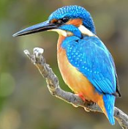
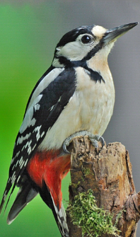
Meet the team!
Mr Lake – Kingfisher class teacher
Mrs Higgins – Woodpecker class teacher
Year 4 LSA’s
Mrs Baird- Kingfisher Class
Mrs Fortune- Woodpecker Class

Slide 3
Structure of the day…
8:50-9:00 Registration
9:00-11:00 Morning session
10:35-10:50 Break time
10:50-12:15 Mid morning session
12:10-1:10 Lunch
1:10- 3:30 Afternoon session
Monday - KS2 assembly Mrs Jones
Tuesday morning - year group/class assembly
Wednesday morning – KS2 singing assembly
Friday morning - Celebration assembly

Slide 4
What does my child need to bring to school?
Daily
Reading record
Reading book
Fortnightly
Times table book
Homework given out on Friday. Please return the following Friday.
Spelling test every Friday.

Slide 5




Slide 6

English

Slide 7
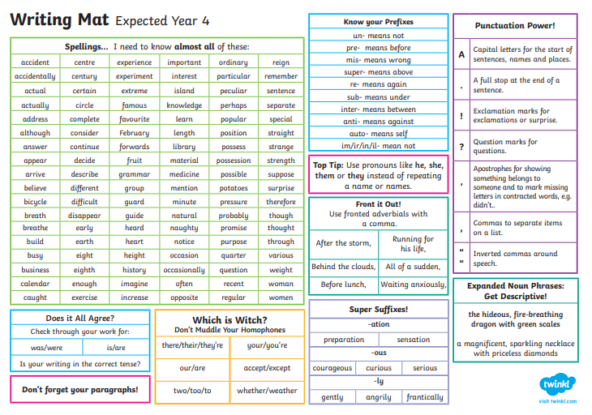

Slide 8
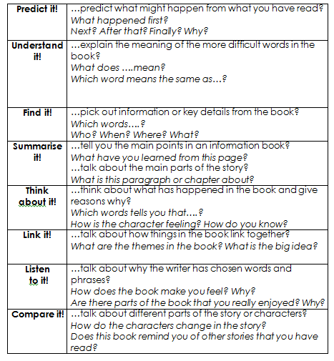
Reading
In lower key stage 2, we teach four twenty minute whole class guided reading sessions each week.
Children will focus on a specific strand in a lesson e.g: vocabulary, retrieval, inference in each session and the fourth session will cover one of the following: summarizing; predicting; identifying/explaining how information/narrative content is related and contributes to the meaning as a whole; identifying and explaining how meaning is enhanced through choice of words and phrases and making comparisons within the text
They are also taught how to answer questions in a test.

Slide 9
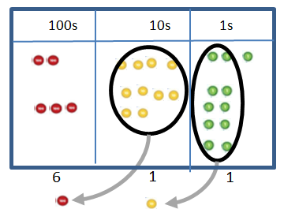
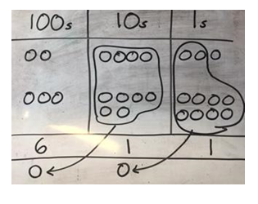

Maths
Concrete
Pictorial
Abstract

Slide 10
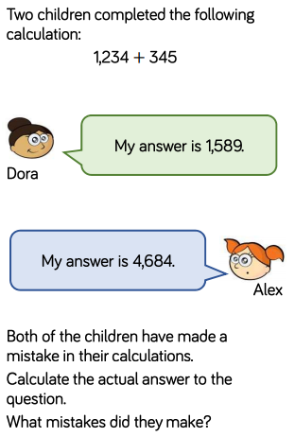

Problem solving & reasoning…

Slide 11

Year 4 Multiplication Check

Slide 12


Slide 13
PE
Your child will be taught P.E on a Wednesday.
Please wear PE kits to school.
Please name all uniform.

Slide 14
Homework expectations
Daily: Five-ten minutes of reading every night
Weekly:
•Spellings: 10words + 5 extra spellings/WTS 5-8 words +2extra
•Maths Problem Solving and Reasoning (20 minutes)
•English Grammar or Punctuation activity (20 minutes)
Fortnightly: Learn a times table
Half termly: Homework menu (please complete at least two tasks)
(Topic, Online Safety, Values, Rights Respecting School and Activity Passport)
Additional activities:
Times Tables Rockstars

Slide 15
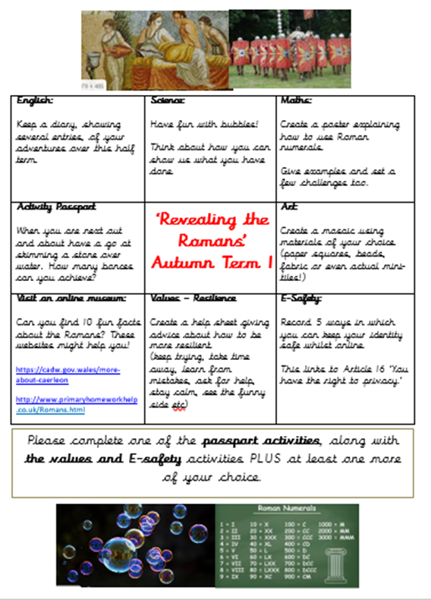


Slide 16
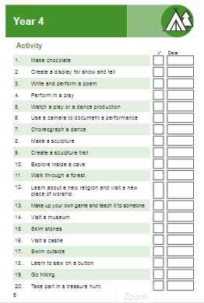


Slide 17


Slide 18
Year group page
https://www.parkfieldschool.co.uk/year-4-3/

Slide 19






Slide 20

How can I support my child at home?

Slide 21
Contact details
Mrs Higgins: woodpecker@parkfieldschool.co.uk
Mr Lake: kingfisher@parkfieldschool.co.uk

Slide 22

Any questions?

