Slide 1

Year 1 Curriculum Evening

Slide 2
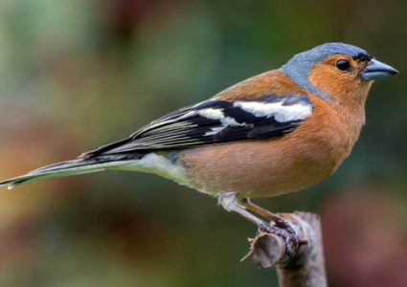
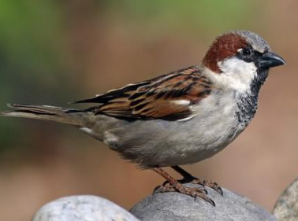
Meet the team!
Mrs Stanford – Chaffinch class teacher
  Mr Parkes - Sparrow class teacher
  Year 1 Learning support assistants
  Miss Harvey & Mrs Medhurst

Slide 3
Structure of the day…
8:45-9:00 Registration
9:00-9.30 Phonics
9:30-10:30 – Morning session
10:30-10:45 Break time
10:45-12:20 Mid-morning session
12:10-13:10 Lunch
13:10- 3:30 Afternoon session
Monday morning - Kindness assembly
Thursday morning – KS1 singing assembly
Friday morning - Celebration assembly

Slide 4
What does my child need to bring to school?
Daily
Reading record
Reading book
Homework given out on Tuesday. Please return the following Monday.
Spelling test every Monday (based on the phonetic sound learnt the previous week).

Slide 5



Curriculum Overview

Slide 6
Writing
In Year 1, children build on the writing skills developed in Reception and begin to write with increasing confidence, independence and stamina.
What we teach:
Writing simple sentences using capital letters, finger spaces and full stops.
Re-reading and checking writing to make sure it makes sense.
Using phonics knowledge to spell words and attempt unfamiliar words independently.
Learning common exception words and key spelling patterns.
Joining words and clauses using and.
Beginning to use different sentence types, including statements, questions and exclamations.
Writing opportunities:
Children will write for a range of purposes throughout the year, including: stories and traditional tales; recounts and diary entries; instructions; information texts; Poems and letters and messages
Transcription and handwriting:
Form all lower-case and capital letters correctly.
Begin to use consistent letter size and orientation.
Spell Year 1 common exception words.
Apply phonics knowledge from Phase 5 and Phase 6 spelling patterns.

Slide 7
How do we teach English writing?
We teach writing through both stories (narrative) and non-fiction texts.
We begin by exploring high-quality texts, learning key vocabulary, identifying the features of the genre and practising the grammar and punctuation needed for successful writing.
During the first week of a new unit, we focus on a specific grammar or punctuation skills and practise transcription (writing) through regular dictation activities, helping children develop their spelling, handwriting and sentence writing.
As a class, we then innovate a model text, making changes together to apply the skills we have learned.
Finally, we plan and write new versions collaboratively before children begin writing more independently.
As the year progresses, they become increasingly confident writers, using their growing knowledge of vocabulary, grammar and text structures to create their own stories and non-fiction texts independently.

Slide 8
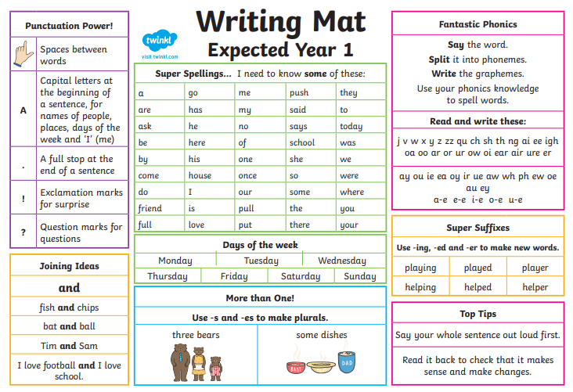

Slide 9
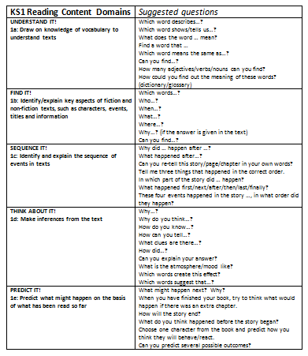
Reading
We teach phonics to read fluently and during these sessions we also read stories and ask questions.
Children will also have the opportunity to 1-1 read- where every child will get listened to within a fortnight.
As the year progresses and their fluency progresses, we then teach whole class guided reading and focus on the reading skills of understanding vocabulary, prediction, retrieval, inference and summarising.

Slide 10
Maths
In Year 1, we follow the NCETM Mastering Number approach to develop a deep understanding of maths. We will use practical resources, pictures and mathematical talk to explore number, calculation, shape and measure. Children are encouraged to explain their thinking, spot patterns and solve problems, helping them to become confident and fluent mathematicians.

Slide 11
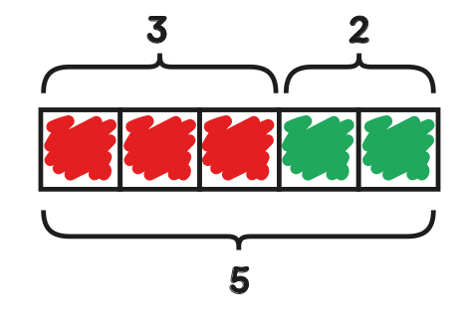
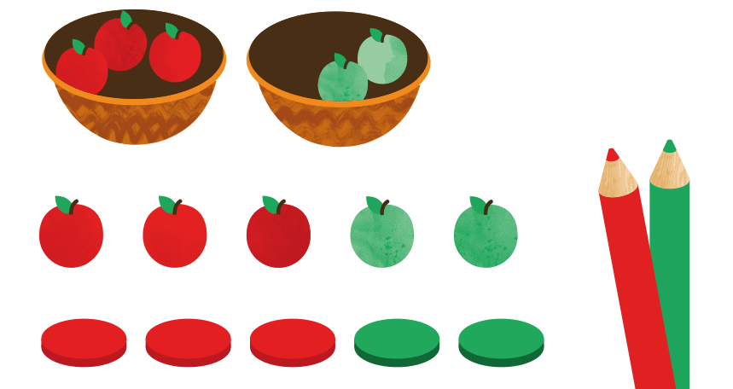
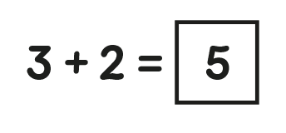
Maths
Concrete
(manipulatives)
Pictorial
Abstract

Slide 12
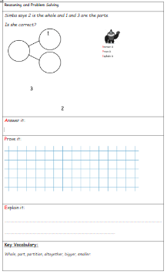
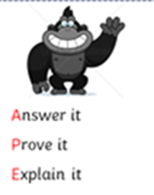
Problem solving & reasoning…

Slide 13
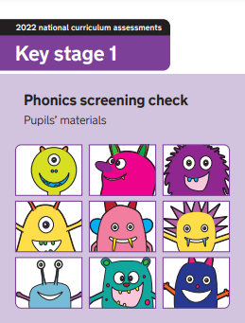
Year 1 Phonics Screening Check
In June, the majority of children will be statutory tested on their ability to use their phonics knowledge to help them decode and read real and nonsense words.
They will read 40 words aloud and will be scored by a familiar adult.
If they do not pass the test, they have another opportunity to re-take the test in Year 2.

Slide 14
Personal, Social, Health and Economic (PSHE) education
PSHE education became statutory for all schools from September 2020.
This Programme of Study sets out learning opportunities based on three core themes:
Health and wellbeing
General wellbeing
Wellbeing Online
Physical health and fitness
Healthy Eating
Health protection and prevention
Basic First Aid (KS2) CPR – all year groups
Developing bodies
Relationships
Families and People who care for me
Caring friendships
Respectful, kind relationships
Living in the wider world
What does it mean to belong to a community?
How can I be a global citizen?
Why does money and work matter?
Online Safety and Awareness (Safety Week)
Being Safe/Personal Safety

Slide 15
PE
Your child will be taught P.E on Wednesday.
Please can children come into school wearing their PE kit.
Please name all uniform.
Check foot size for trainers/daps
Miss Crane

Slide 16
Homework expectations
“An investment in your child.”
Daily: five minutes of reading every night
Weekly
Spellings: 10 spellings for all children/5 spellings for some groups
Arithmetic or English Grammar or Punctuation activity (15 minutes)
Fortnightly: Learn number bonds
Additional activities: When appropriate we introduce Times Tables Rockstars
Half termly: Homework menu (complete a minimum of 2)
(Topic, Online Safety, Values, Rights Respecting School and Activity Passport)

Slide 17
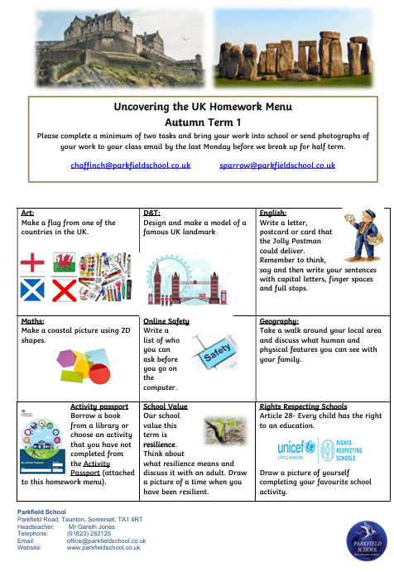
The Homework Menu is designed to give children the opportunity to show their talents in other areas of the curriculum, as well as reading, writing and maths.
Making sure children are safe is our top priority at school, so we do include an online safety task too.
In addition to the above we also include a school value, activity passport and Rights Respecting School task.
Please try and complete a minimum of two tasks and either bring in what you’ve done or send a picture to the class email.
chaffinch@parkfieldschool.co.uk
sparrow@parkfieldschool.co.uk

Slide 18

We are a Rights Respecting School and have gained the Gold Award. Children’s voice is important to us and for them to understand that they have rights and to respect.
There are four key areas of impact for children at a Rights Respecting school; wellbeing, participation, relationships and self-esteem.
The difference that a Rights Respecting School makes goes beyond the school gates, making a positive impact on the whole community.
Children are healthier and happier
Children feel safe
Children have better relationships
Children become active and involved in school life and the wider world

Slide 19

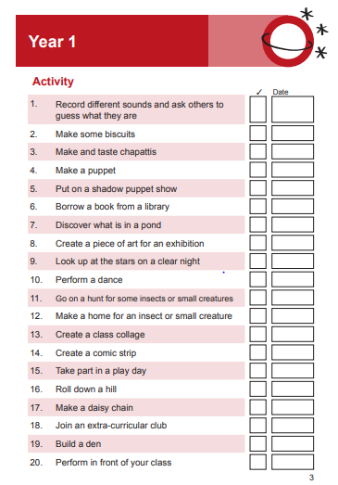
Activity passport task.
A copy of this will come home with your homework menu.

Slide 20
Year group page
https://www.parkfieldschool.co.uk/children/year-group-pages/year-1

Slide 21





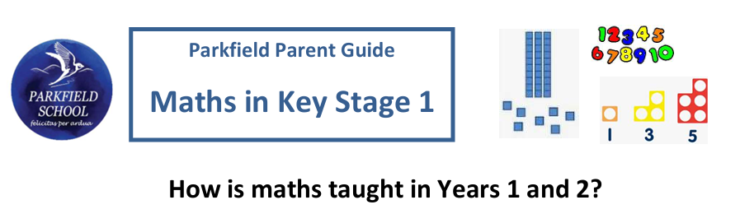

Slide 22
Contact details…
Mr Parkes: sparrow@parkfieldschool.co.uk
Mrs Stanford: chaffinch@parkfieldschool.co.uk
Miss Crane

Slide 23
Any questions?
Please speak with the class teachers if you have any queries or would like further clarification or details of your child’s learning.
Thank you for your time.

