Slide 1

Year 1 Curriculum Evening

Slide 2
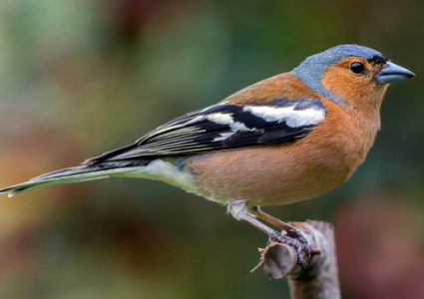
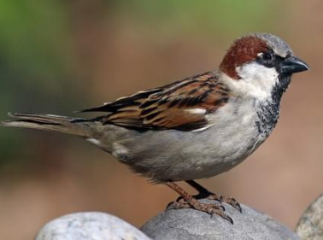
Meet the team!
Mrs Lefever – Chaffinch class teacher
  Miss Brooks – Chaffinch learning support assistant
  Mr Parkes – Sparrow class teacher
  Mrs Roller and Mrs Sokolowska – Sparrow learning support assistants

Slide 3
Structure of the day…
8:45-9:00 Registration
9:00-9.30 Phonics
9:30-10:30 Morning session (English)
10:30-10:45 Break time
10:45-12:20 Mid-morning session (Maths)
12:20-13:20 Lunch
12:50-15:30 Afternoon session (Foundation)
Monday morning – Kindness assembly
Thursday morning – KS1 singing assembly
Friday morning – Celebration assembly

Slide 4
What does my child need to bring to school?
Daily
Reading record
Reading book
Homework given out on Tuesday. Please return the following Monday.
Spelling test every Monday (based on the phonetic sound learnt that week).

Slide 5



Curriculum Overview

Slide 6
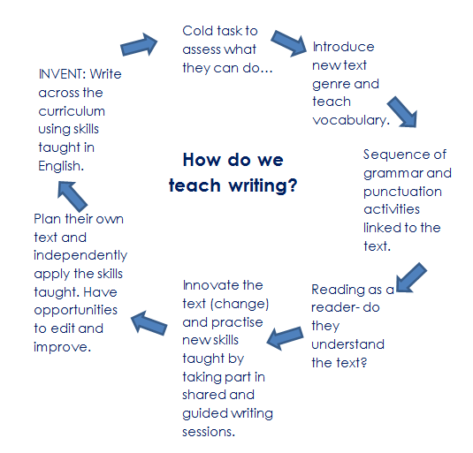
English

Slide 7
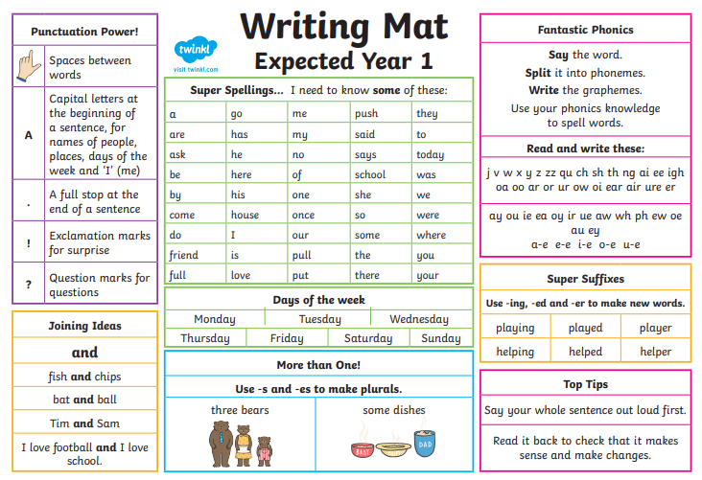

Slide 8
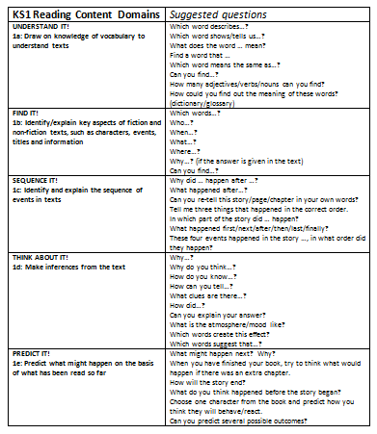
Reading
We teach reading in small reading sessions and focus on the key reading skills.
The children have opportunities to apply the skills taught in follow up activities.
In addition to the above, the children also revise grammar and punctuation or independently read.

Slide 9
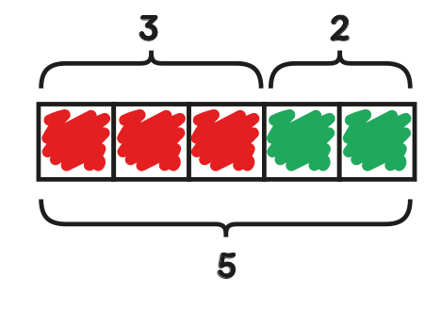
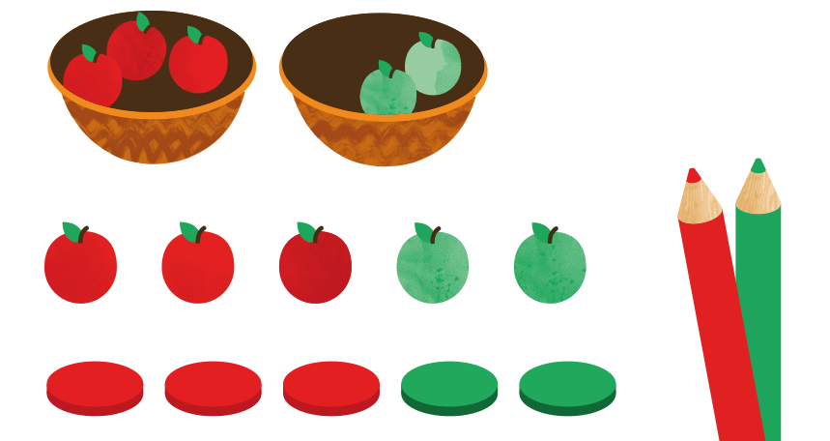

Maths
Concrete
(manipulatives)
Pictorial
Abstract

Slide 10
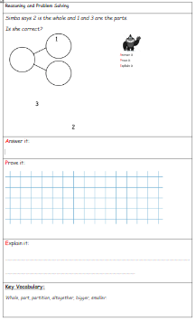
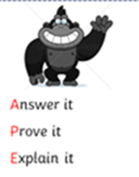
Problem solving & reasoning…

Slide 11
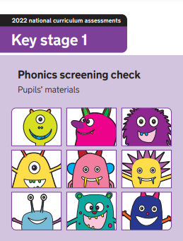
Year 1 Phonics Screening Check
In June, the majority of children will be statutory tested on their ability to use their phonics knowledge to help them decode and read real and nonsense words.
They will read 40 words aloud and will be scored by a familiar adult.
If they do not pass the test, they have another opportunity to re-take the test in Year 2.

Slide 12
Personal, Social, Health and Economic (PSHE) education
PSHE education became statutory for all schools from September 2020.
This Programme of Study sets out learning opportunities based on three core themes:
Health and wellbeing
  How can I stay mentally and physically well?
  What happens when I grow and change?
Relationships
  Why are families and friendships so important?
  How do we respect ourselves and others?
  What do safe relationships mean?
Living in the wider world
  What does it mean to belong to a community?
  What is media literacy and digital resilience?
  How can I be a global citizen?
  Why does money and work matter?

Slide 13
PE
Your child will be taught P.E on Thursdays.
Please can children come into school wearing their PE kit.
Please name all uniform.
Check foot size for trainers/daps

Slide 14
Homework expectations
“An investment in your child.”
Daily: five minutes of reading every night
Weekly
Spellings: 10 spellings for all children/5 spellings for some groups
Arithmetic or English Grammar or Punctuation activity (15 minutes)
Fortnightly: Learn number bonds
Additional activities: When appropriate we introduce Times Tables Rockstars
Half termly: Homework menu (complete a minimum of 2)
(Topic, Online Safety, Values, Rights Respecting School and Activity Passport)

Slide 15
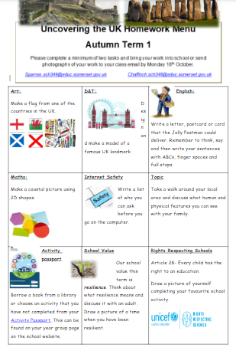
The Homework Menu is designed to give children the opportunity to show their talents in other areas of the curriculum, as well as reading, writing and maths.
Making sure children are safe is our top priority at school, so we do include an online safety task too.
In addition to the above we also include a school value, activity passport and Rights Respecting School task.
Please try and complete a minimum of two tasks and either bring in what you’ve done or send a picture to the class email.
chaffinch@parkfieldschool.co.uk
sparrow@parkfieldschool.co.uk

Slide 16

We are a Rights Respecting School and have gained the Gold Award. Children’s voice is important to us and for them to understand that they have rights and to respect.
There are four key areas of impact for children at a Rights Respecting school; wellbeing, participation, relationships and self-esteem.
The difference that a Rights Respecting School makes goes beyond the school gates, making a positive impact on the whole community.
Children are healthier and happier
Children feel safe
Children have better relationships
Children become active and involved in school life and the wider world

Slide 17

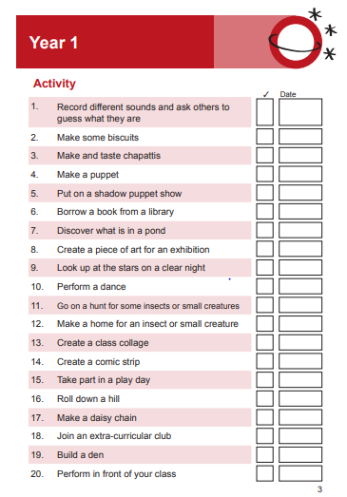
Activity passport task.
A copy of this will come home with your homework menu.

Slide 18
Year group page
https://www.parkfieldschool.co.uk/children/year-group-pages/year-1

Slide 19
Contact details…
Mr Parkes: sparrow@parkfieldschool.co.uk
Mrs Lefever: chaffinch@parkfieldschool.co.uk

Slide 20

Any questions?
Please speak with the class teachers if you have any queries or would like further clarification or details of your child’s learning.
Thank you for your time.

