Slide 1

Year 3 Curriculum Evening

Slide 2
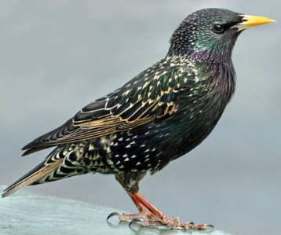
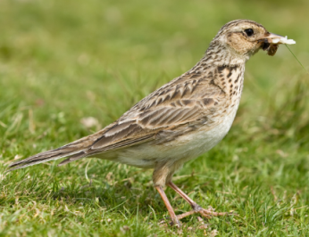
Meet the team!
Mrs Higgins
Starling class teacher
Miss Isaacs
Skylark class teacher
LSAs
Mrs Lopalco– Starling Class
Mrs Browne LSA (1:1) Mrs Bolt and Miss Truby – Skylark Class

Slide 3
Structure of the day…
8:50-9:00 Registration
9:00-10:30 Morning session
10:30-10:45 Break time
10:45-12:15 Mid morning session
12:15-1:15 Lunch
1:15- 3:30 Afternoon session
Monday morning - KS2 assembly Mr Jones
Tuesday morning - year group/class assembly
Wednesday morning – KS2 singing assembly
Friday morning - Celebration assembly

Slide 4
What does my child need to bring to school?
Daily
Reading record
Reading book
Times table book
Spelling book
Homework given out on Fridays. Please return the following Thursday.
Spelling test and times tables test every Friday.

Slide 5


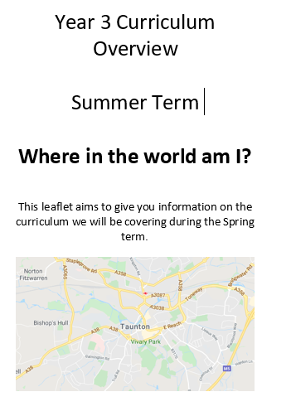
Curriculum Overview

Slide 6

English

Slide 7
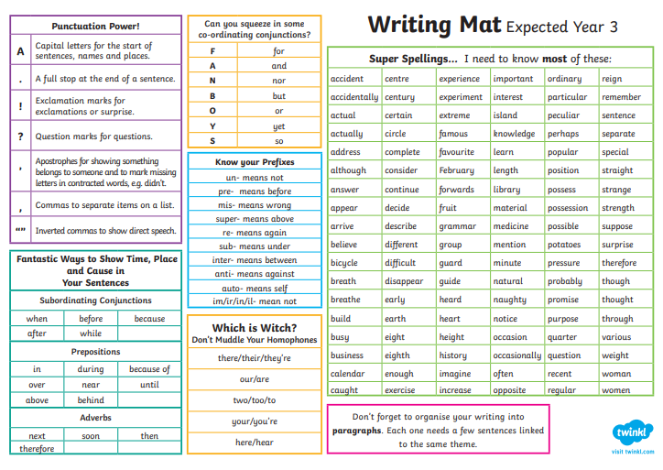

Slide 8
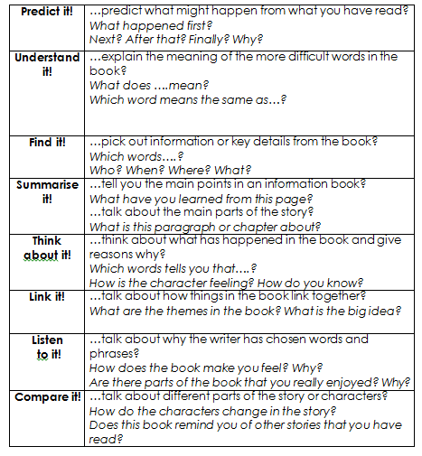
Reading
In lower key stage 2, we teach four twenty minute whole class guided reading sessions each week.
Children will focus on a specific strand in a lesson e.g: vocabulary, retrieval, inference in each session and the fourth session will cover one of the following: summarizing; predicting; identifying/explaining how information/narrative content is related and contributes to the meaning as a whole; identifying and explaining how meaning is enhanced through choice of words and phrases and making comparisons within the text
They are also taught how to answer questions in a test.

Slide 9
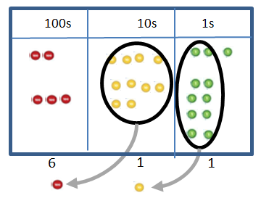
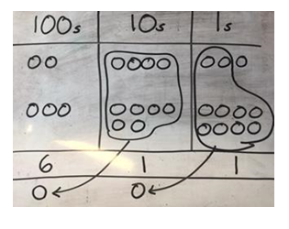
Maths
243
+368
611
1 1
Concrete
Pictorial
Abstract

Slide 10
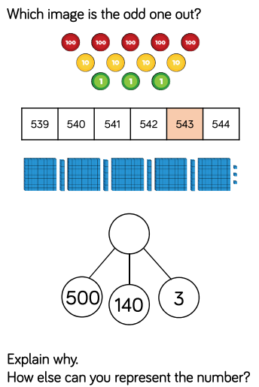
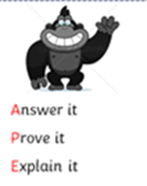
Problem solving & reasoning…

Slide 11
Personal, Social, Health and Economic (PSHE) education
PSHE education became statutory for all schools from September 2020.
This Programme of Study sets out learning opportunities based on three core themes:
Health and wellbeing
  How can I stay mentally and physically well?
  What happens when I grow and change?
Relationships
  Why are families and friendships so important?
  How do we respect ourselves and others?
  What do safe relationships mean?
Living in the wider world
  What does it mean to belong to a community?
  What is media literacy and digital resilience?
  How can I be a global citizen?
  Why does money and work matter?

Slide 12
P.E
Your child will have PE on a Tuesday.
Please come into school wearing PE kit.
Please name all uniform.

Slide 13
Homework expectations
Daily: Five-ten minutes of reading every night
Weekly
Spellings:10words + 5 extra spellings/WTS 5-8 words +2extra
Maths Problem Solving and Reasoning (20 minutes)
English Grammar or Punctuation activity (20 minutes)
Fortnightly: Learn a times table
Half termly: Homework menu (complete a minimum of 2)
(Topic, Online Safety, Values, Rights Respecting School and Activity Passport)
Additional activities: Times Tables Rockstars

Slide 14
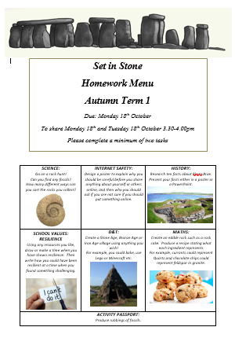
The Homework Menu is designed to give children the opportunity to show their talents in other areas of the curriculum, as well as reading, writing and maths. ​
Making sure children are safe is our top priority at school, so we do include an online safety task too.​
In addition to the above we also include a school value, activity passport and Rights Respecting School task. ​
Please try and complete a minimum of two tasks. ​
​

Slide 15


Slide 16

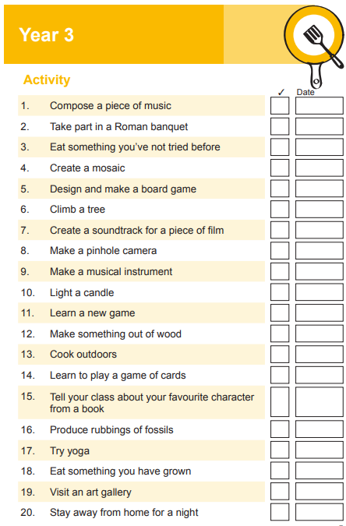

Slide 17
Year group page
http://www.parkfieldschool.co.uk/year-3-3/

Slide 18
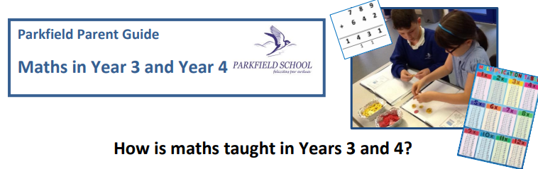






Slide 19
Contact details
Mrs Higgins: starling@parkfieldschool.co.uk
Miss Isaacs: skylark@parkfieldschool.co.uk

Slide 20

Any questions?

