Slide 1

Year 2 Curriculum Evening
2025

Slide 2
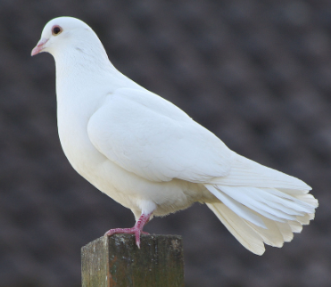
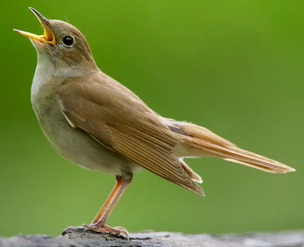
Meet the team!
Mrs Farley & Mrs Critchard– Dove class teachers
Mrs Bamford & Mrs Ball –Nightingale class teachers
LSA’s
Dove: Miss Harvey, Mr Brunning & Mrs Denovan-Smith
Nightingale: Mrs Medhurst & Mrs Musgrave

Slide 3
Structure of the day…
8:40-9:00 Registration and morning task
9:00-10:45 Morning session (Phonics, handwriting and English)
10:45-11:00 Break time
11:00-12:20 Mid-morning session (Number Sense & Maths)
12:20-1:20 Lunch
1:20- 3:15 Afternoon session
3:15-3:30 Story and Pack up for home time
Monday morning – Whole school assembly/kindness assembly
Thursday morning – KS1 singing assembly
Friday morning - Celebration assembly

Slide 4
What does my child need to bring to school?
Daily
Reading record
Reading book
Water bottle
Homework given out on FRIDAY Please return the following THURSDAY – or before if it is done!
Spelling test every MONDAY - linked to phonics
Times tables tested on a Thursday and results returned to child on Thursday. (Starting with the 10 times table after half term)

Slide 5


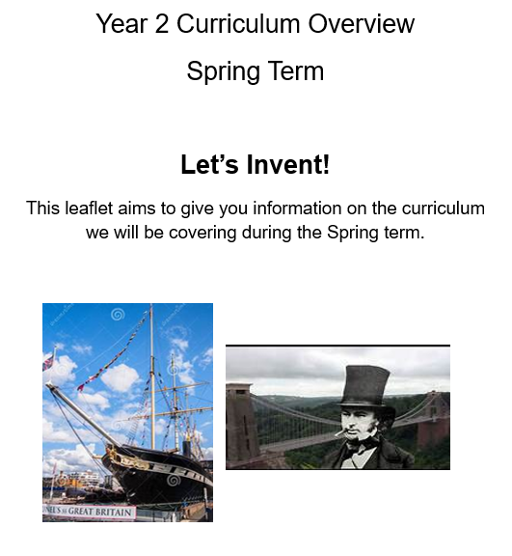
Curriculum Overview

Slide 6
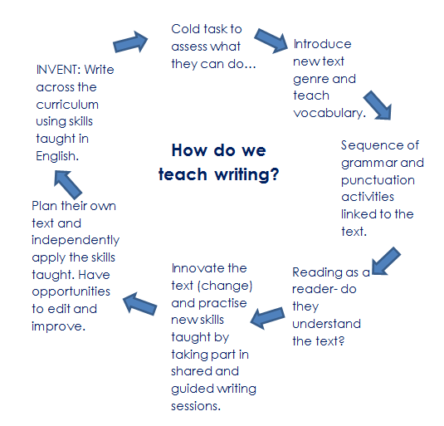
English
Some texts we study:
The Rainbow Fish
Stepping Out - poetry
Brunel – NCR
Hansel and Gretel
Letter Writing
Pinocchio
From a Railway Carriage – poetry
Encanto
Beegu
Judaism NCR
Postcards - Brunel

Slide 7
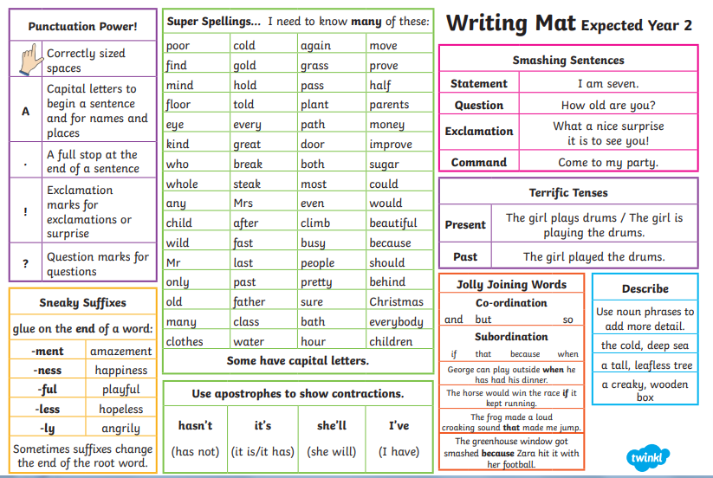

Slide 8
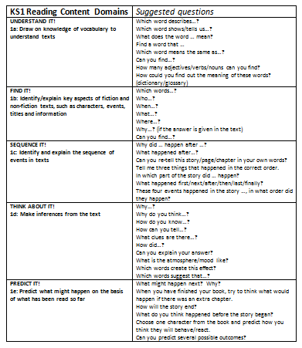
Reading
In Year 2 we teach reading in whole class guided reading sessions, where the children will focus on a specific strand in a lesson e.g: vocabulary, retrieval, prediction, inference & sequencing.
They are also taught how to answer questions in the context of written comprehension.

Slide 9

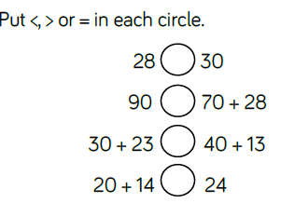
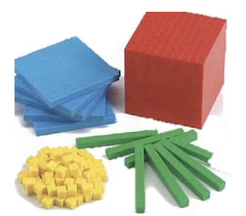
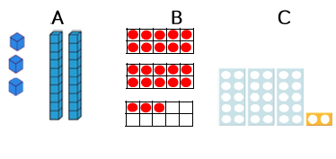



Maths
Pictorial
Concrete - manipulatives
Abstract
A systematic approach to teaching factual fluency. It provides exactly what we need to achieve factual fluency in additive and multiplicative facts for each and every child.

Slide 10
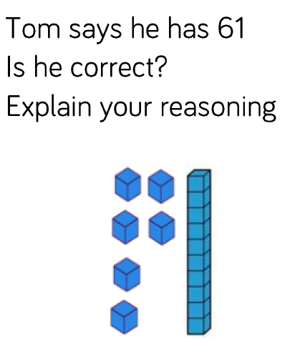
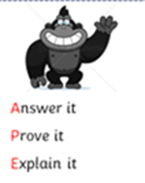
Problem solving & reasoning…
Embedded within each lesson is the opportunity for PSR – application of mathematical concepts. We promote oracy through the use of sentence stems to support the children in their reasoning.
Our plenary/BTLT question will always be a PSR question which we will discuss and model.
Times tables – Hit the button (Topmarks), TTRS, songs chanting, quickfire questions.
multiplication and division facts eg 2x10, 20/2 etc

Slide 11
Optional End of Key Stage 1 Assessments
Although the assessments are no longer statutory, as a school we have chosen to continue to use the materials provided by the government as an end of key stage check point. These can be done when we choose and can be done in the same manner as other assessments carried out during the year.
Maths - Arithmetic
Problem solving and reasoning
Reading - Comprehension
Spelling, punctuation and grammar
Writing - continues to be assessed through teacher assessment throughout the year.

Slide 12
Personal, Social, Health and Economic (PSHE) education
PSHE education became statutory for all schools from September 2020.
This Programme of Study sets out learning opportunities based on three core themes:
Health and wellbeing
  How can I stay mentally and physically well?
  What happens when I grow and change?
Relationships
  Why are families and friendships so important?
  How do we respect ourselves and others?
  What do safe relationships mean?
Living in the wider world
  What does it mean to belong to a community?
  What is media literacy and digital resilience?
  How can I be a global citizen?
  Why does money and work matter?

Slide 13
PE
Your child will be taught P.E on Wednesday .
Please can children come into school wearing their PE kit.
Please name all uniform!

Slide 14
Homework expectations
Daily: 5-10 minutes of reading every night. Please sign your child’s diary. Times Tables practice as much as you can.
Weekly
Spellings:10 spellings for all children/5 spellings for some groups.
Arithmetic or English Grammar or Punctuation activity, (approx 15 minutes)
Additional activities: Times Tables Rockstars, NumBots, Hit the Button.
Half termly: Homework menu (complete a minimum of 2) (Topic, Online Safety, Values, Rights Respecting School and Activity Passport)

Slide 15
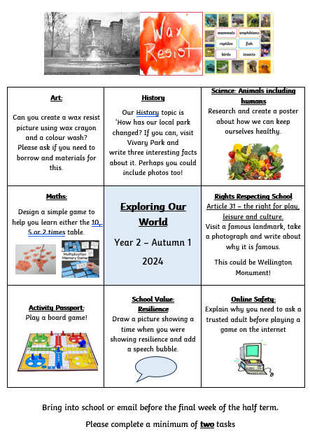
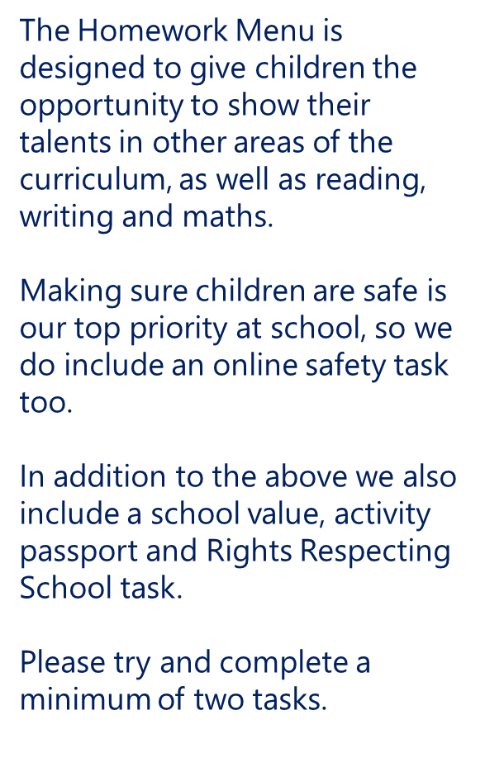

Slide 16

We are a Rights Respecting School and have gained the Gold Award. Children’s voice is important to us and for them to understand that they have rights and to respect.
There are four key areas of impact for children at a Rights Respecting school; wellbeing, participation, relationships and self-esteem.
The difference that a Rights Respecting School makes goes beyond the school gates, making a positive impact on the whole community.
Children are healthier and happier
Children feel safe
Children have better relationships
Children become active and involved in school life and the wider world

Slide 17
Contact details…
Mrs Farley & Mrs Critchard: dove@parkfieldschool.co.uk
Mrs Bamford: nightingale@parkfieldschool.co.uk
Anything urgent, please catch us in the morning or send an email/message to the office.

Slide 18
How can I support my child at home?
Regular reading
Support with homework
Spellings and times tables
Board games and outside activities
Encourage good sleep habits

Slide 19
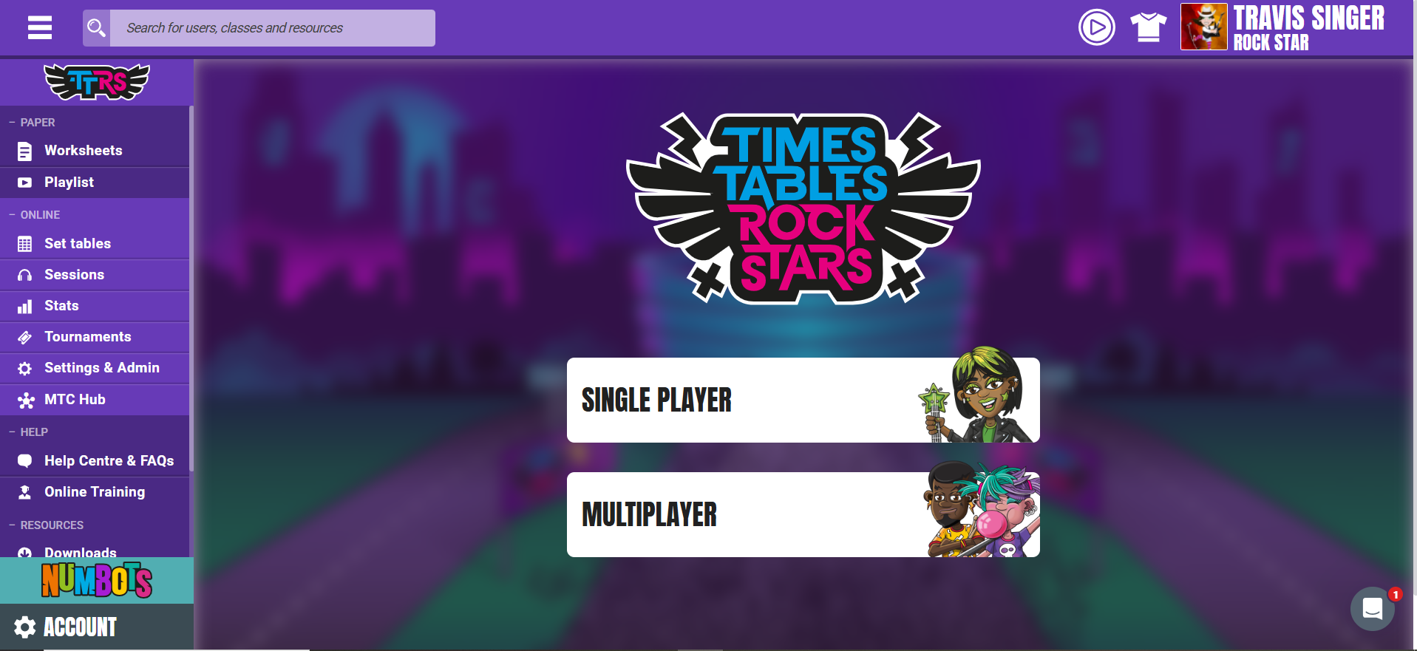

How can I support my child at home?
https://play.ttrockstars.com/
https://www.topmarks.co.uk/

Slide 20

Any questions?

Slide 21







